Slide 1
Feeding, Elopement, and Toileting
2022 World TSC Conference
Valerie Volkert, PhD, BCBA-D
Mindy Scheithauer, PhD, BCBA-D
Joanna Lomas Mevers, PhD, BCBA-D
July 29, 2022

Slide 2
Medical/Behavior Interactions
When addressing feeding difficulties, elopement, or toilet training (or any challenging behavior) ruling out physiological factors is an important first step.
Examples:
  Toileting concerns may be a result of or complicated by constipation
  Feeding difficulties can be brought on and exacerbated by Eosinophilic-esophagitis
When it is not possible to rule out medical issues, behavioral strategies can still be implemented, but progress may be limited and treatment planning may rely more on trial-and-error

Slide 3
Caregiver Mediation
To produce positive outcomes, behavioral interventions must be implemented consistently over time
The effects of behavioral interventions can be specific to a particular setting or person
Thus, to see the benefits at home, behavioral interventions typically must be implemented by caregivers
  Requires realistic assessment of individual circumstances and prioritization

Slide 4
The Impact/Effort Ratio
What will work
What’s possible to implement

Slide 5
1 Step Backwards → 2 Steps Forward
To make progress, behavioral interventions it is often necessary to take a step back to “re-establish control” or set a new baseline
  Feeding: begin with foods the individual will accept before fading non-preferred foods back in
  Elopement: take short, well-controlled practice trips to community settings before reintroducing regular outings
  Toileting: establish a schedule with frequent caregiver-initiated trips to the toilet before expecting self-initiation

Slide 6
Data Collection/Tracking
It is important to track target behavior (elopement attempts, bites consumed, continent/incontinent urinations, etc.)
  Efficiency
    Don’t spend time doing something that isn’t working
    Don’t spend time doing something that is working instead of pushing the envelope
  Helps you communicate and coordinate service providers
Set clear definitions for the behavior to be consistent
  Consider the effort involved (e.g., count every bite vs. finished a serving)

Slide 7
Reinforcement
Any consequence that increases the behavior that preceded it
  KEY: It is only a reinforcer if it results in an increase in behavior
Types of Reinforcers
  Functional: the consequence that occurs naturally and causes the behavior to keep happening
  Arbitrary: a consequence that is not related to the behavior of interest, but may be powerful enough to change behavior
Identifying reinforcers (preference assessments)
  Preferences can shift (sometimes quickly)
  Although there are some systematic approaches, providing “in the moment” choices is a good way to identify preferences

Slide 8
Reinforcement
Any consequence that increases the behavior that preceded it
  KEY: It is only a reinforcer if it results in an increase in behavior
Types of Reinforcers
  Functional: the consequence that occurs naturally and causes the behavior to keep happening
  Arbitrary: a consequence that is not related to the behavior of interest, but may be powerful enough to change behavior
Identifying reinforcers (preference assessments)
  Preferences can shift (sometimes quickly)
  Although there are some systematic approaches, providing “in the moment” choices is a good way to identify preferences

Slide 9
Feeding

Slide 10

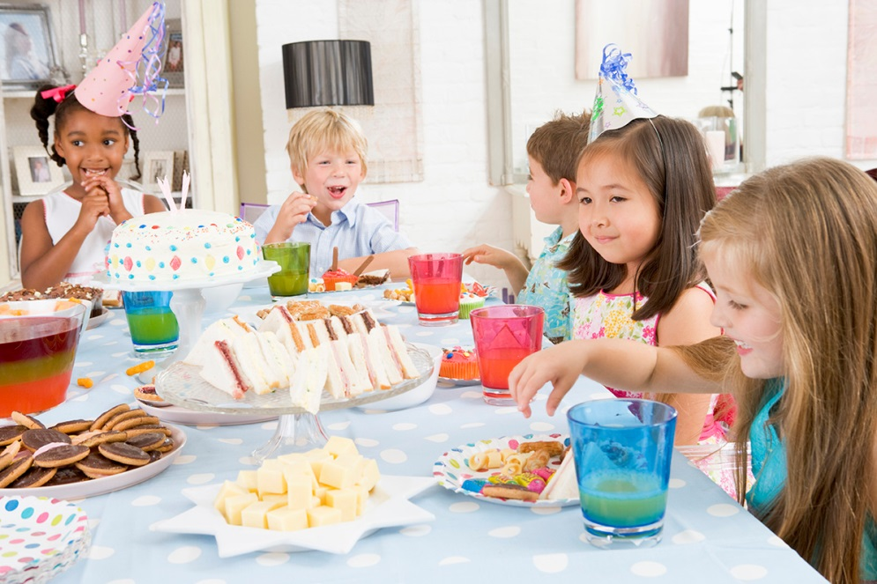

Feeding Behavior
No human activity has greater biological and social significance than feeding

Slide 11
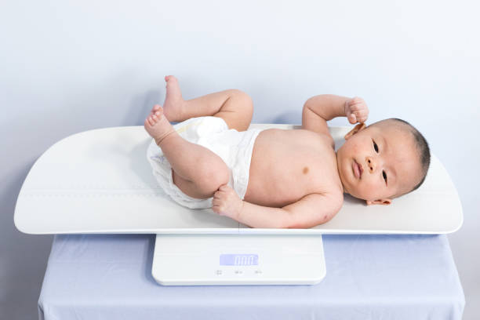
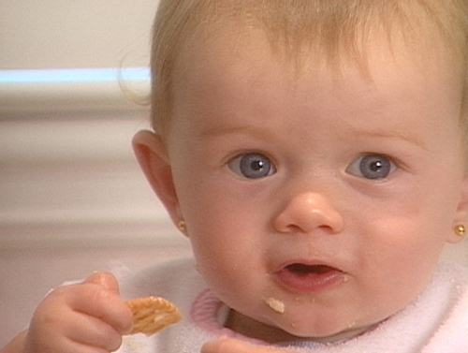
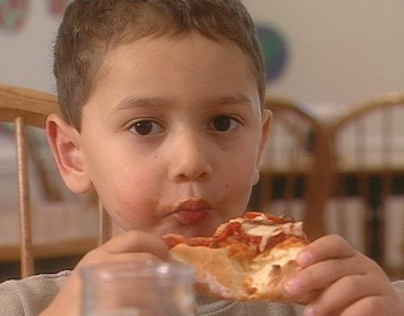
Feeding Behavior
  Achievement of feeding milestones
Successful feeding is measured against a set of social and cultural standards
  Achievement of adequate physical growth

Slide 12
Feeding Timeline
Relies on breast milk & formula
Self-feeds with independence during meals
Begins solids
Starts finger feeding
Uses spoon and/or cup
24 to 36 months
12 to 18 months
8 to 10 months
4 to 6 months
Birth to 4 months

Slide 13
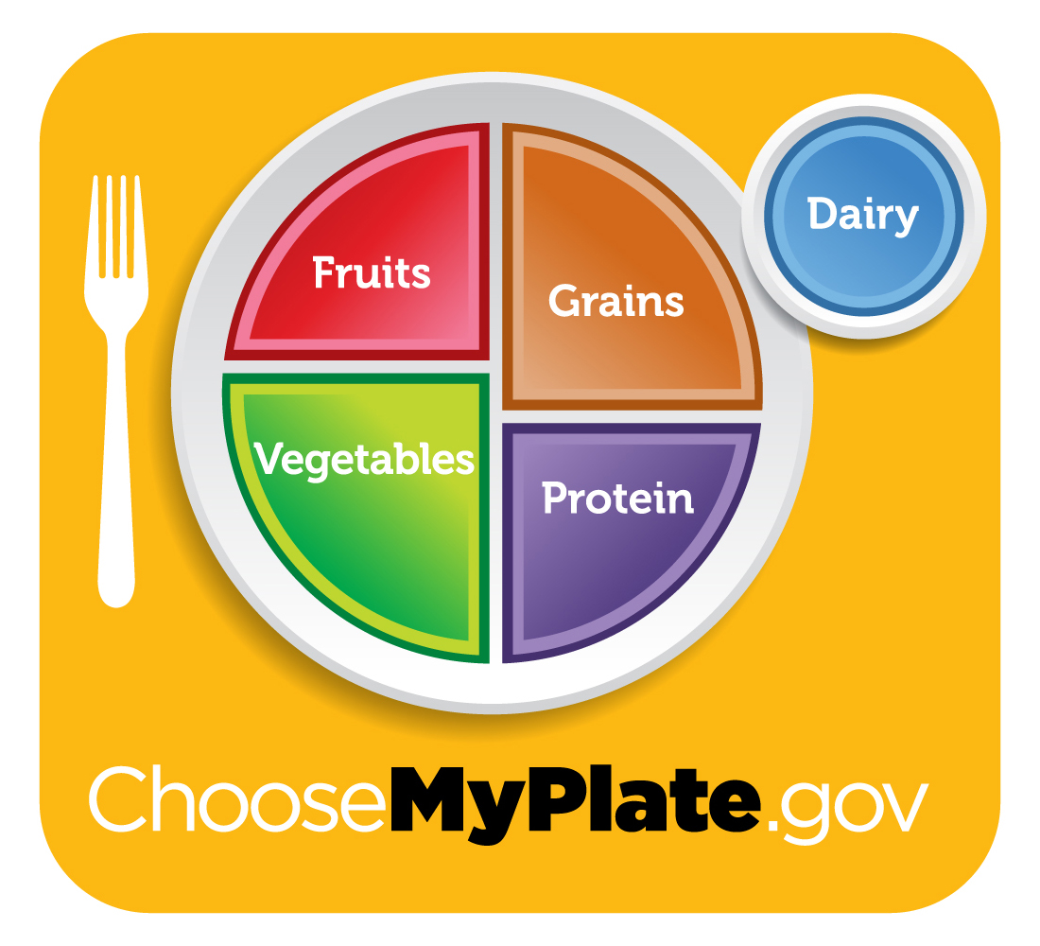
The Goal

Slide 14
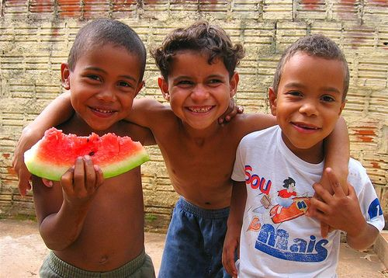

Most Children Enjoy Eating

Slide 15


Picky Eating

Slide 16
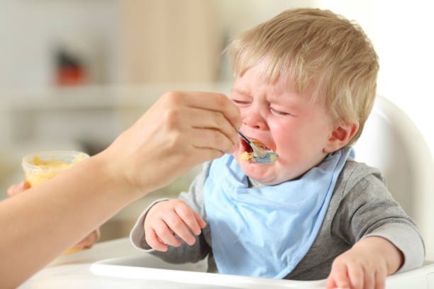
Chronic Feeding Issues

Slide 17
Picky Eating
The estimated prevalence of picky eating is 22%
Almost a quarter of children aged 2 years are picky eaters
  Overall, parents perceive picky eating as an occasional behavior
(Cole, An, Lee, & Donovan, 2017)

Slide 18

Picky Eating
The estimated prevalence of picky eating is 22%
Almost a quarter of children aged 2 years are picky eaters
  Overall, parents perceive picky eating as an occasional behavior
(Cole, An, Lee, & Donovan, 2017)

Slide 19
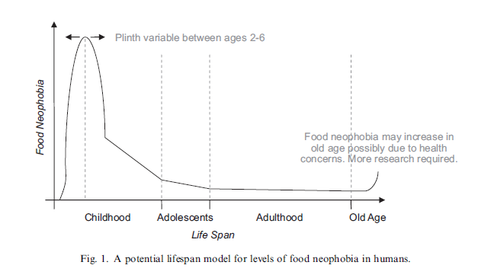
Food Neophobia
Reluctance or avoidance of new foods
Evolutionarily beneficial survival mechanism to help children avoid ingesting noxious or toxic chemicals
  “reject bitter”

Slide 20
Typical versus Disordered Feeding
Typical | Disordered
Accepts breast milk or formula | Has difficulty breast or formula feeding
Starts baby food around 4 to 6 months of age | Consistently rejects baby foods
Transitions to mashed table foods by 12 months of age | Has difficulty transitioning to mashed table foods
Picky eating emerges at 18 months of age | Reaction to non-preferred food is excessive

Slide 21
Typical versus Disordered Feeding
Typical | Disordered
Variety will reemerge with exposure | Inflexible food preferences may change, but variety remains restricted
Variety will be sufficient to provide adequate nutrition | Variety does not provide adequate nutrition
Preferences are influenced by peers | Insensitive to social cues around eating
Eating persists in different environmental conditions | Eating is disrupted in different conditions
Will eat non-preferred food when hungry | Will not eat non-preferred food even when hungry

Slide 22

DSM-5 Definition
An eating or feeding disturbance (e.g., apparent lack of interest in eating or food; avoidance based on the sensory characteristics of food; concern about aversive consequences of eating) as manifested by persistent failure to meet appropriate nutritional and/or energy needs associated with one (or more) of the following:

Slide 23
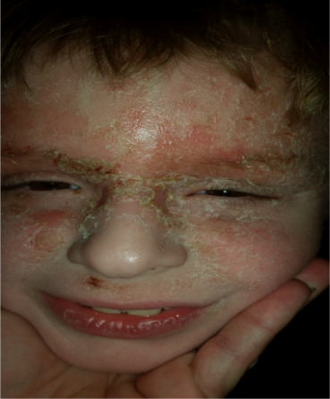
ARFID
Significant weight loss, failure to achieve expected weight gain, or faltering growth
Significant nutritional deficiency
A1
A2

Slide 24

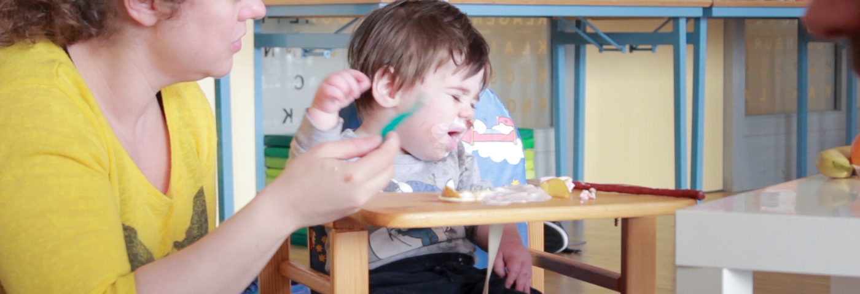
ARFID
Dependence on enteral feeding or oral nutritional supplements
Marked interference with social functioning
A3
A4

Slide 25
DSM-5 Definition of ARFID
B. The disturbance is not better explained by lack of available food or by an associated culturally sanctioned practice.
C. The eating disturbance does not occur exclusively during the course of anorexia nervosa or bulimia nervosa, and there is no evidence of a disturbance in the way in which one’s body weight or shape is experienced.
D. The eating disturbance is not attributable to a concurrent medical condition or not better explained by another mental disorder. When the eating disturbance occurs in the context of another condition or disorder, the severity of the eating disturbance exceeds that routinely associated with the condition or disorder and warrants additional clinical attention.
Notes:
In the psychology world this is the definition- maybe Will to Barb handoff here

Slide 26
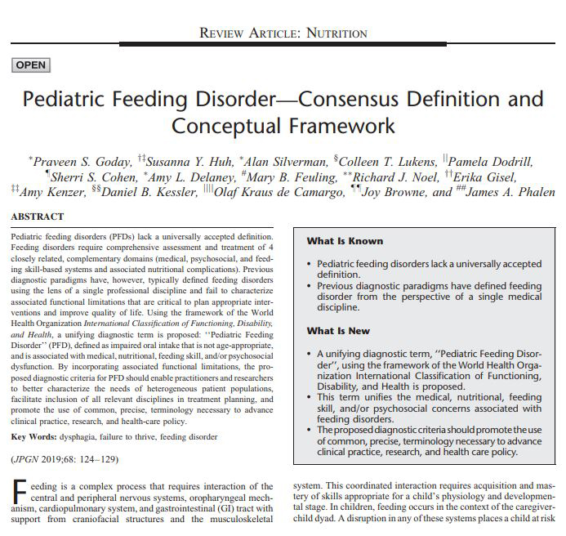
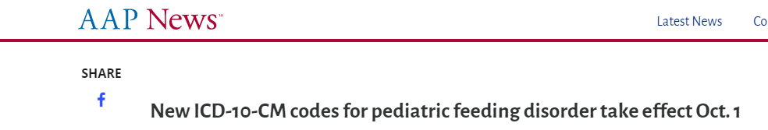


Notes:
Our consensus paper was published in JPGN in January 2019. This laid the groundwork for our Power of a Name campaign. Lately this paper has been cited over 50x per month in other medical journals showing the reach it is beginning to have in the medical community. It is also in the 99% of popularity of all journals for an article of a similar age.

Slide 27
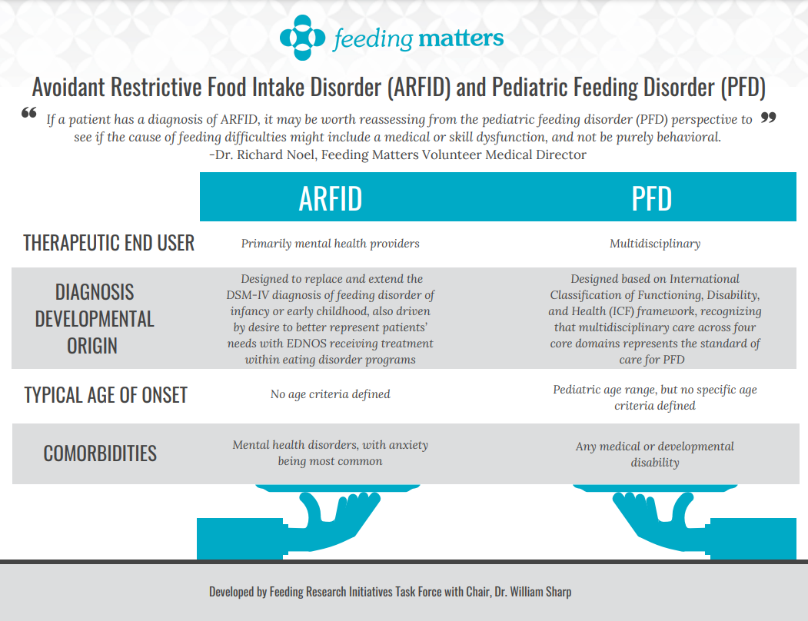

Slide 28
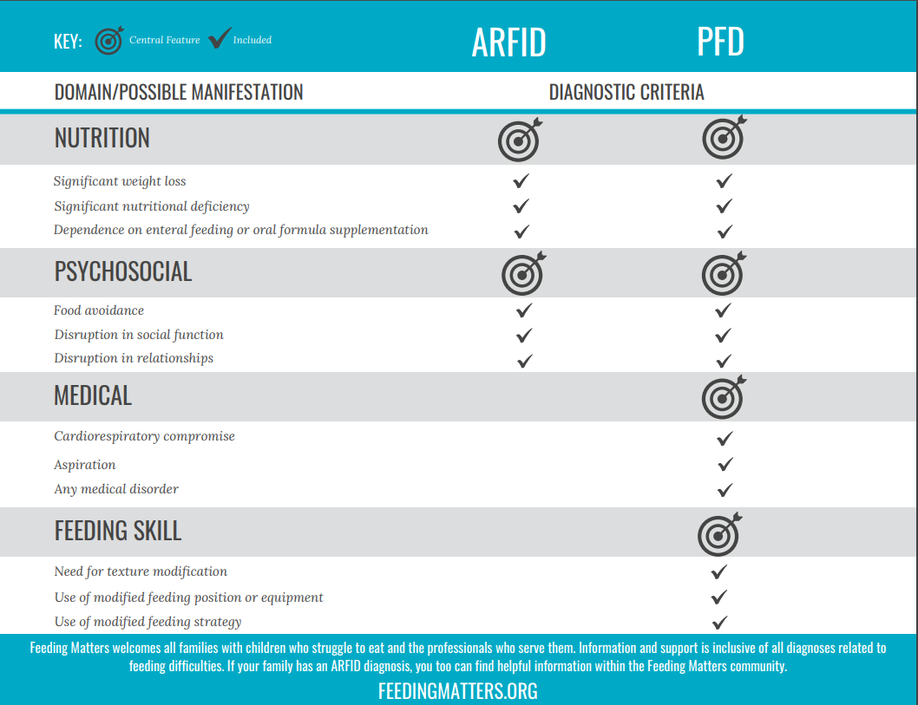

Slide 29

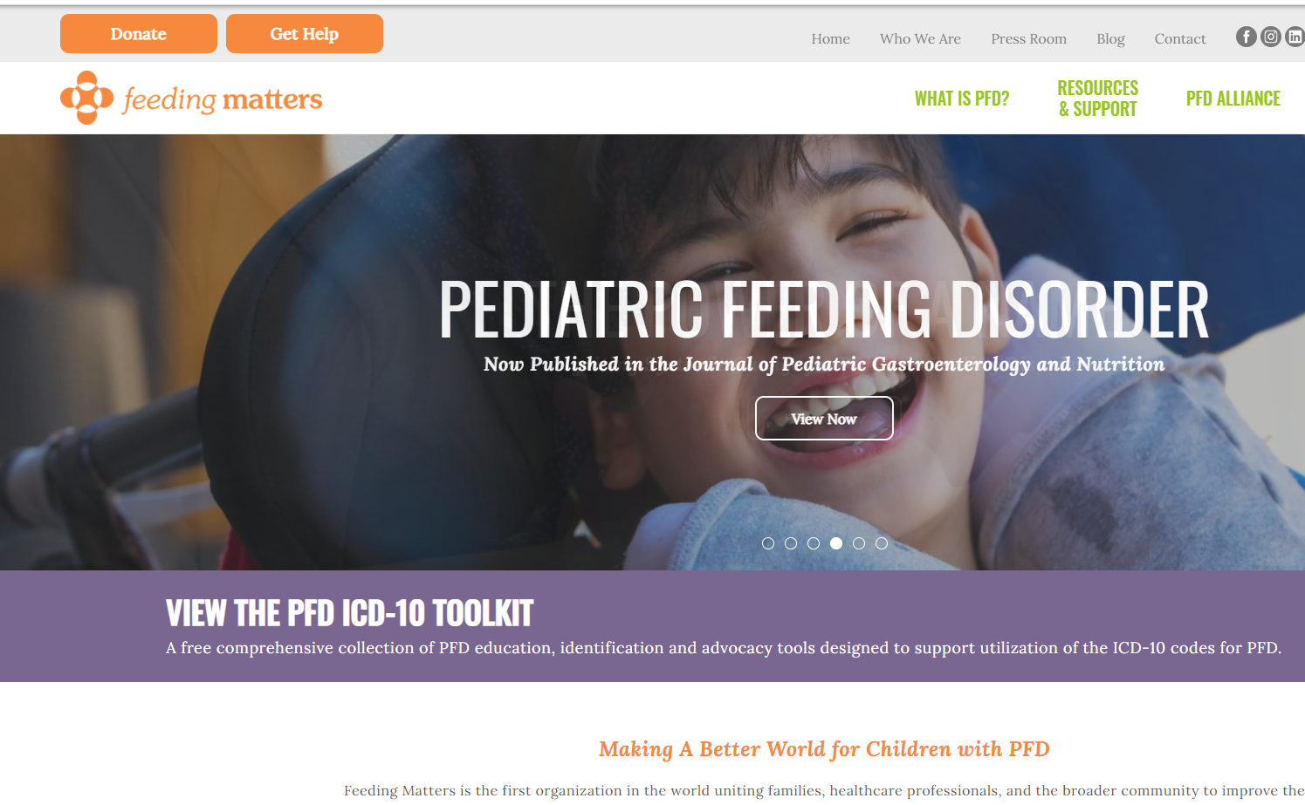
RESOURCES
FEEDING MATTERS
feedingmatters.org/toolkit
Fact sheets, screeners, infographics and advocacy tools for PFD
Notes:
To equip our community with the tools necessary for these three steps: identification, validation and accessing care, we authored the PFD- ICD-10 Toolkit.

Slide 30
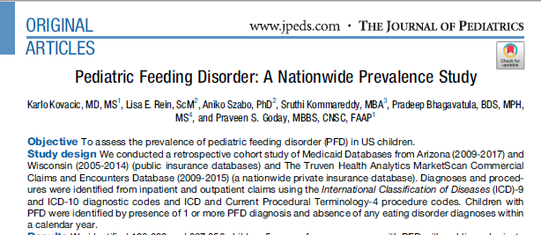
Annual prevalence of PFD in US children is between 1 in 23 (4%) and 1 in 37 (3%) children under 5 years of age
Annual prevalence is between 1 in 3 (30%) and 1 in 5 (20%) in children under 5 years of age with other chronic diseases

Slide 31

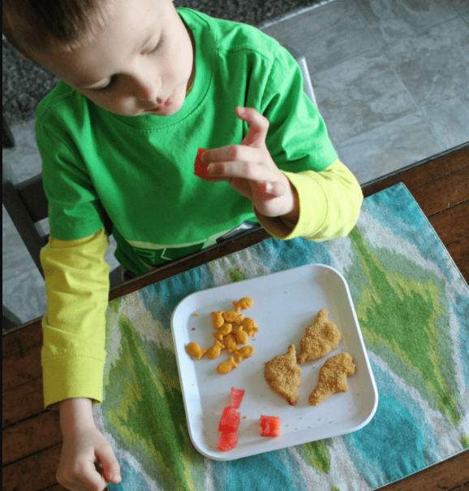
Two Distinct Clinical Presentation
A
B

Slide 32
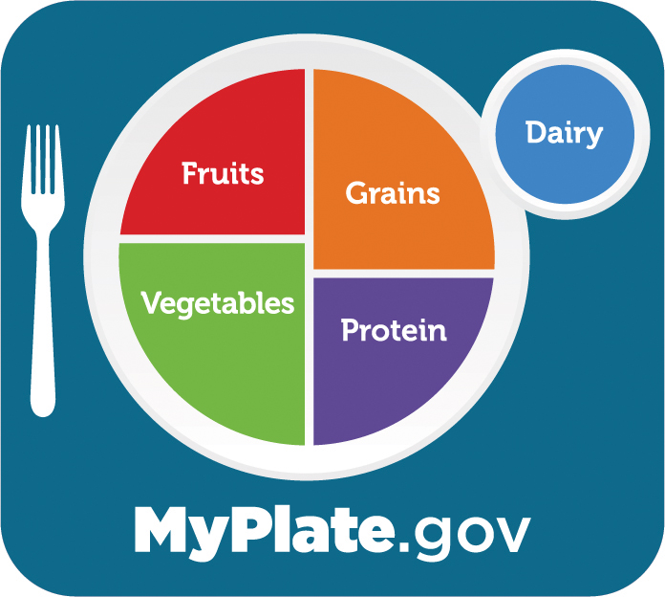
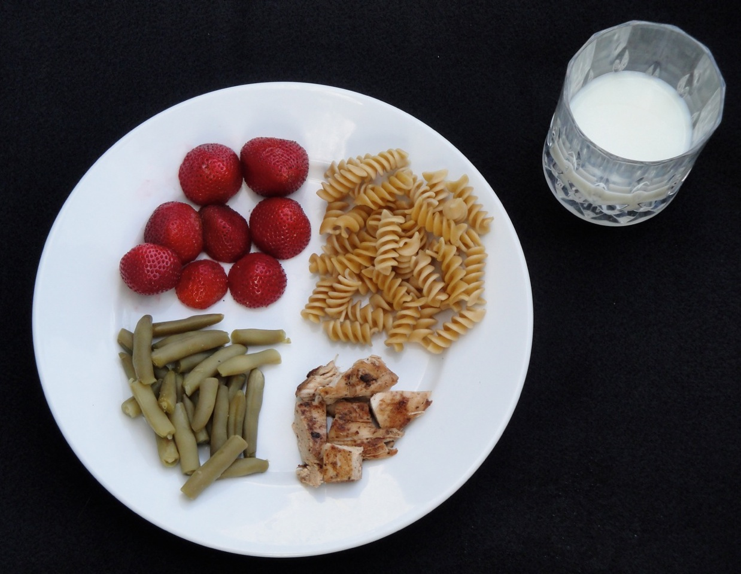
Nutrition Targets

Slide 33

Volume Concerns
A (A1; A3)

Slide 34
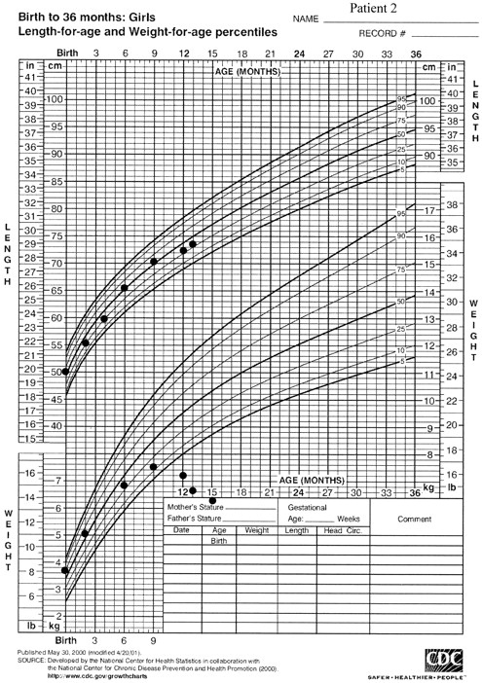
Volume: Medical Detection

Slide 35
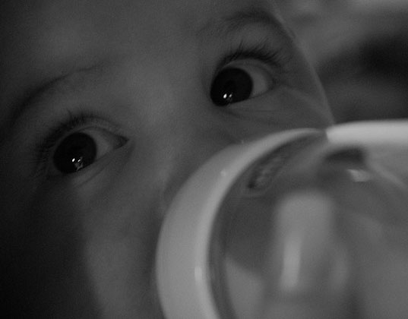
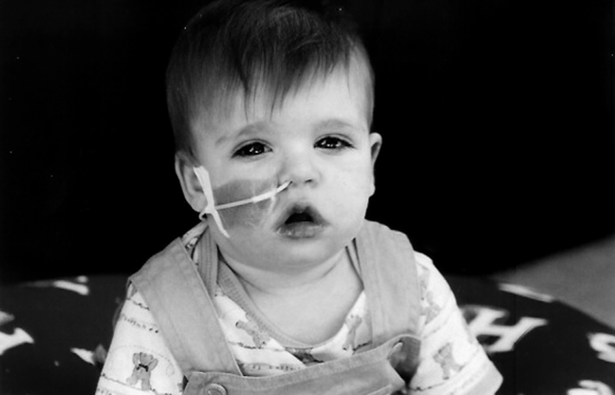
Volume: Medical Management
feeding tube
formula supplementation

Slide 36
Volume: Associated Factors
  Medical Issues: Congenital or acquired respiratory, cardiac, and gastrointestinal problems, which cause difficult or painful eating experiences
  These include:
    Gastroesophageal reflux
    Complex cardiac conditions
    Food allergies
    Gastroenteritis
    Dysmotility
    Prematurity (with intubation)
    Bronchopulmonary dysplasia
    Short bowel syndrome
    Lactose intolerance

Slide 37
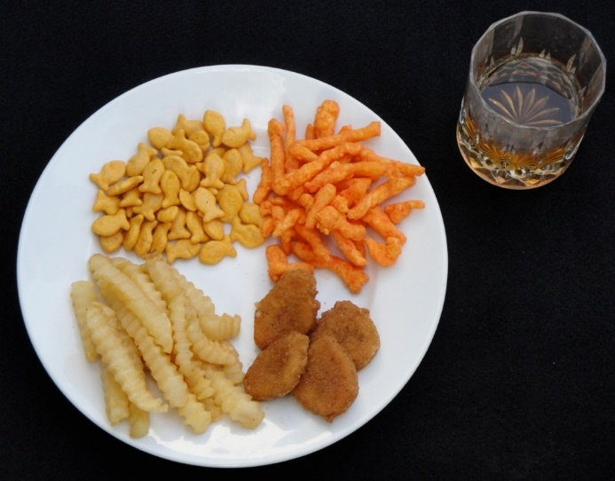
Variety Concerns
B (A2)

Slide 38
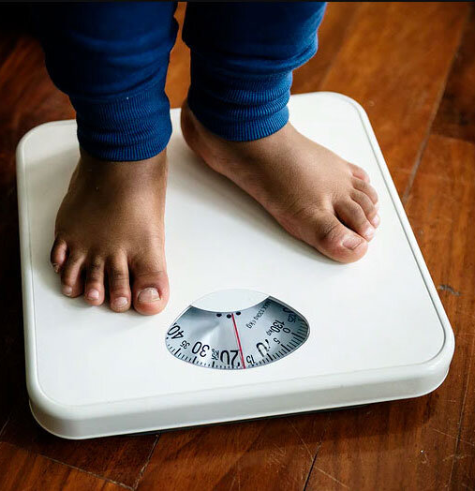
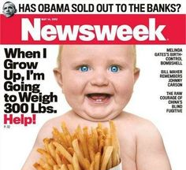
Variety Concerns: Medical Detection

Slide 39
Variety Concerns: Medical Management
Nutritionally complete drinks
Multivitamins
Concern here:
  Child may reject it
  Child may become dependent on it
  Child may become increasingly restrictive and drop foods

Slide 40
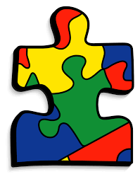
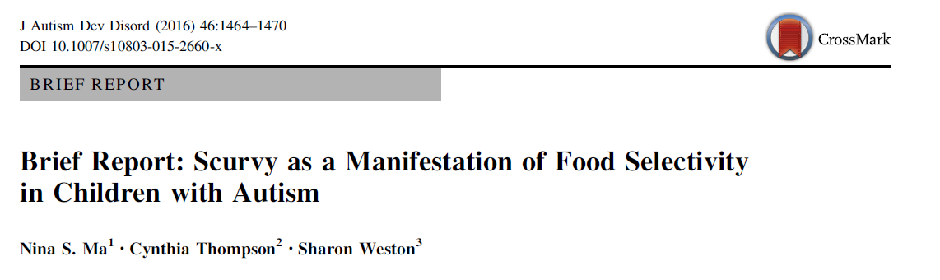
Variety Concerns: Associated Factors
Autism Spectrum Disorder
Anxiety
  Note: Often overlooked due to weight status or viewed as part of a “typical American diet”

Slide 41

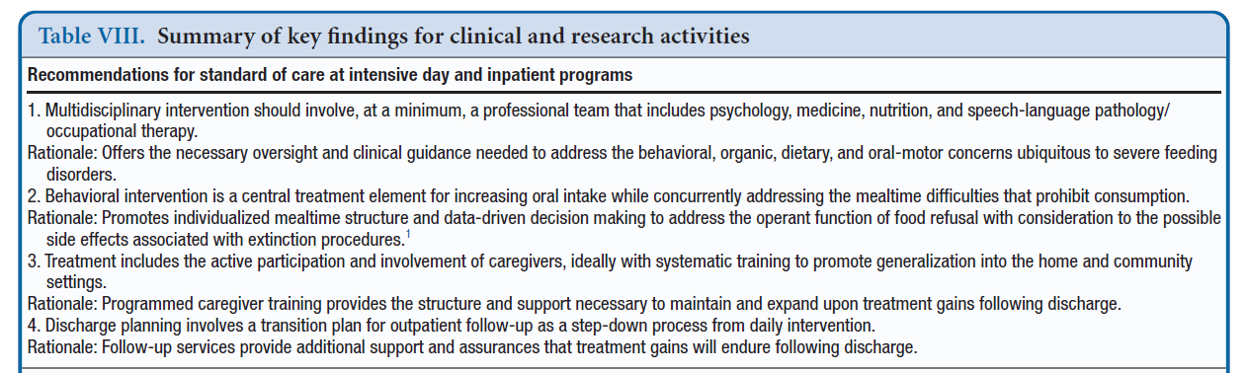

Slide 42
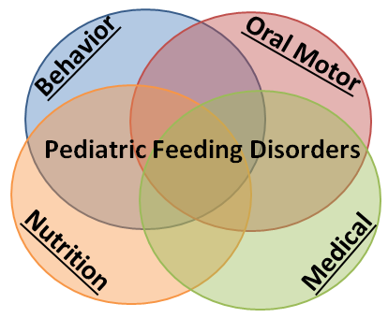
Multidisciplinary Approach
Notes:
Throughout treatment we utilize an interdisciplinary approach. The etiology of severe feeding problems is multifaceted, and we know that children typically have difficulties in each of these 4 areas: behavior, oral motor, nutrition, and medical.
So during their admission to our program, each child has a highly trained treatment team consisting of clinicians from each field: two bachelor or masters level therapists, a licensed dietitian, an oral motor specialist, a licensed psychologist who serves as the case manager, as well as nurses and a pediatric gastroenterologist who provide medical oversight.
Each of us has some distinct responsibilities, but there is also considerable overlap between areas.

Slide 43
Four Pillars of the Feeding Intervention
Multidisciplinary intervention should involve, at a minimum, a professional team that includes psychology, medicine, nutrition, and speech-language pathology/ occupational therapy (Sharp et al., 2017).
Medicine
Nutrition
Skill
Behavior
  Assesses safety to initiate feeding intervention and provides ongoing oversight of possible medical needs
  Monitors growth and nutritional intake and provide oversight to ensure children are provided with balanced nutrition, grow appropriately, and tolerate new foods
  Focuses on reducing hypersensitivity to gagging and new food textures while building oral-motor coordination related to chewing, tongue control, swallowing and self-feeding
Structures meals using behavior analysis and related techniques to promote intake of new foods; conduct caregiver training to support generalization
Notes:
The Marcus Model

Slide 44
The “Special Sauce”
Psychology – Oversees the behavioral protocols
Structured Meals based on Applied Behavior Analysis
Nutrition – Nutritional intake and meal planning
Medicine – ID/Treat Organic Factors
Skill – Safety and Texture Advancement

Slide 45

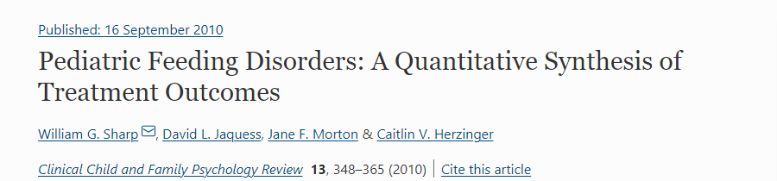
The “Special Sauce”
20 + year history of research focused on feeding intervention
Structured Meals based on Applied Behavior Analysis
Effect Size (d) = 2.46
  54 studies
  109 participants

Slide 46
General Behavioral Concepts
Treatment involves:
Persistence with a Demand
Escape Extinction
Levels-
Ignoring refusal behavior
Nonremoval of the presentation
Recognition of Appropriate Behaviors
Differential Reinforcement
Types-
Praise and attention
Access to preferred activities
Consumption of preferred food
Escape / break
Notes:
Must make contact with the food to learn
Need to be appropriately motivated

Slide 47
General Behavioral Concepts
Treatment involves:
Enriched Environment
Noncontingent Access
Types-
Attention
Preferred Toys/Activities
Reduce Motivation to Escape
Antecedent Manipulation
Types-
Reduce food amount (bite size)
Reduce food texture
Notes:
Must make contact with the food to learn
Need to be appropriately motivated

Slide 48

Treatment Approach: Goal Driven
Goals should be:
  Individualized
  Observable
  Measurable
  Sample goals:
  Increase total oral intake to 40-50% of needs
  Increase variety by 8 new foods
  Increase acceptance of solids to 80%
  Decrease inappropriate mealtime behavior to 1 per minute or less

Slide 49
Structuring the Meal
Why is it important to structure meals?
  Creates a predictable environment for the child
  Ensures the expectations of the meal are clear to the child
  Allows for systematic changes when implementing treatment components
Notes:
-playing a game, Farnam street,
-exam

Slide 50
Structuring the Meal
Identify foods that will be presented
Identify food type
Specify foods by name, food group, brand, recipe
Identify food texture
Precisely describe how texture is achieved
Peanut butter and jelly sandwich | Puree
Brand:Creamy JIF peanutbutter, Kroger Squeezable Grape Jelly, Kroger Wheat/White Bread | Blend bread dry first. Heat 1 T of peanut butter and 1 T of jelly in microwave for 20 seconds. Gradually pour mixture and 3.5 oz. of milk into blender. Puree until smooth.

Slide 51
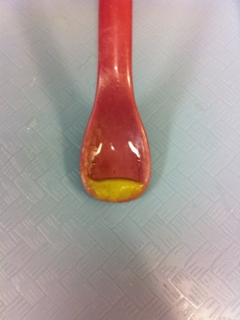
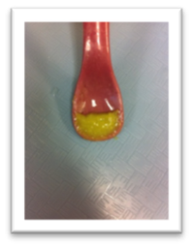
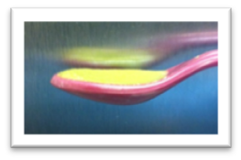
Structuring the Meal
Liquids | Solids
Empty cup | Empty spoon
1/16 oz | ¼ level
1/8 oz | ½ level
1/4 oz | Full level
Examples of bolus sizes for liquids and solids

Slide 52
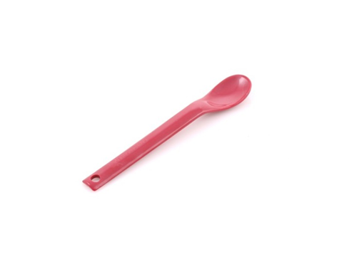
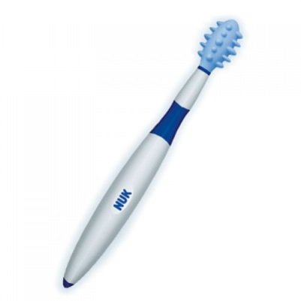
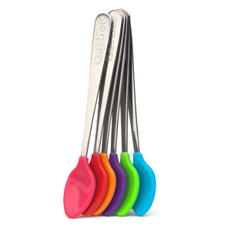
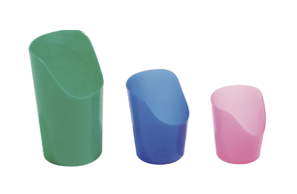
Therapeutic Tools
Plastic coated baby spoons
Maroon spoons
Nuk brush
Flexi-cut (nosey) cups
Notes:
The Maroon spoon is widely used for working with children who have problems such as poor lip closure, oral hypersensitivity, or tongue thrust. The narrow, shallow bowl of the spoon makes it ideal for feeding therapy. The small spoon has a 1" bowl, the large spoon has a 1.25" bowl. Both are 6" long.
While extremely tough and break-resistant, these spoons are not recommended for use with children with severe bite reflex.

Slide 53
Structuring the Meal
Mealtime rules:
  Make rules that are feasible for you to follow through with
  State the rules to the child before each meal
  Make sure everyone feeding is using the same rules
  Follow through

Slide 54
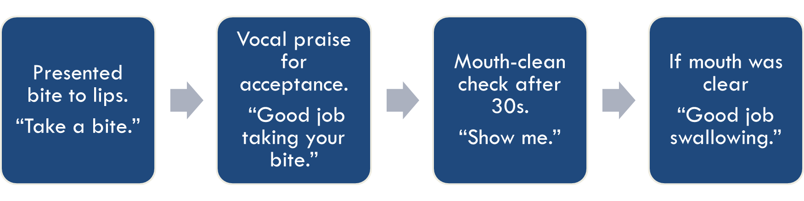
Structuring the Meal
Length of meal
  Time based (e.g., 5 min, 15 min)
  Bite or drink based (e.g., 1 bite, 5 bites)
  Set the child up for success
  What is feasible for follow through?

Slide 55

  Feeding behavior is quantified and measured precisely
  Feeding behavior is quantified and measured precisely
Notes:
We use a computer program to take data on laptop computers. We collect real time data, so we recording behavior as it is occurring.

Slide 56
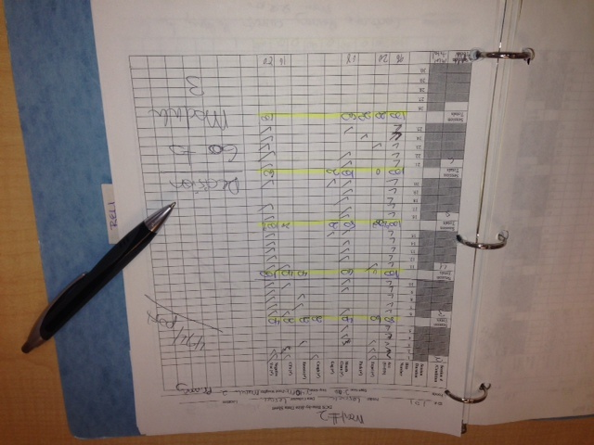
Operationally Defining Behavior
Identify foods that will be presented
Used to remove ambiguity and ensure all data collectors are measuring same behavior
Data Collection
  Computer data
  Paper and pencil data
  Clicker data
Notes:
-An operational definition, when applied to data collection, is a clear, concise detailed definition of a measure.
-The need for operational definitions is fundamental when collecting data.
-Used to remove ambiguity and ensure all data collectors have the same understanding
-you want to ensure that the data is representing what you are saying is represents

Slide 57

Promoting Healthy Eating
Strategies you can provide to caregiver to promote healthy eating

Slide 58

Strategies to Promote Healthy Eating
Establish a meal and snack schedule
  Limit meals to 30 minutes
Serve meals in the kitchen or dining area
  Limit the child from walking around
  Use age-appropriate seating (e.g., booster seat)
  Limit distractions during mealtime (e.g., TV or tablet)
(Williams & Foxx, 2007)

Slide 59

Strategies to Promote Healthy Eating
Entire family should model eating a wide range of foods
  Do not express dislike of a particular food in front of child
Repeatedly offer new foods
  Exposure to a flavor 15-20 times increases liking of the flavor (Birch & Marlin, 1982)
  “No thank you” bite during meals

Slide 60

Strategies to Promote Healthy Eating

Slide 61


Strategies to Promote Healthy Eating
Appropriate mealtime behavior
  Provide enthusiastic attention and praise immediately following good behavior (e.g., smelling or licking the food)
Unwanted mealtime behavior
  Ignore refusal behaviors and age-appropriate messiness
    Including saying anything, sighing, facial expressions
  (Williams & Foxx, 2007)

Slide 62


Strategies to Promote Healthy Eating
Start with a single, small bite
  On separate plate
  On plate with preferred food

Slide 63
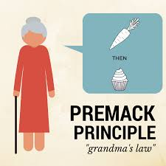
Strategies to Promote Healthy Eating
To Premack, or not to Premack
If using preferred foods is undesired as a motivator to consume new foods, try tangible nonfood items or activities
  (Williams & Fox, 2007)

Slide 64

Resource

Slide 65

Toilet Training

Slide 66
Toileting
Typically developing children achieve continence by 2-4 years of age¹
Children diagnosed with developmental delays often achieve continence later in life or never at all²
  ¹Tsai, et al., 1981; ²Blum, et al., 2004

Slide 67


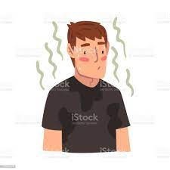
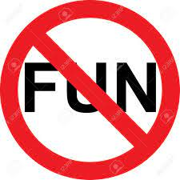
Impact of Incontinence
Increase Burden of Care^{2,3}
Negative impact on hygiene, physical comfort, and independence^{2,1}
Stress for Caregivers
Social stigma limits exposure to
important life experiences⁴
      ¹Macias, et al., 2006 ; ²Cicero & Pfadt, 2002; ³Sells-Love, et al., 2002; ⁴Demsey, 2005;

Slide 68

Factors that can influence training
At least 18 months of age (it’s never too late to start trying!)
Medical/physiological
  Infection/illness
  Constipation
  Diarrhea
  Medications child is taking
  Spinal cord dysfunction

Slide 69


Factors that can influence training
Social/Communication Skills
  Asks to go to the bathroom/talks about bathroom
  Understands bathroom lingo
  Indicates when he/she/they are wet/soiled
  Follows you when you go and watches
Motor Skills
  Stand up and sit down
  Pull up/off pants/underwear
Notes:
These are preferred and indicate more readiness but if these skills are difficult for your child you can still try. People without these prerequisite skills can become toilet trained! You don’t need to wait for all of the pre-requisites !
If child still having accidents, make sure to see a medical doctor to rule out any physiological/medical concerns. If that is not an issue than wait awhile and try again. Perhaps your child just needs to develop a little more and then he/she will be ready.

Slide 70
Treatment Components
Fluid Loading

Slide 71
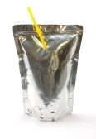

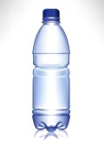
Fluid Loading
Providing access and encouragement to drink preferred liquids
The more opportunity to practice the skill the better!

Slide 72
When you need to check with a medical provider about fluid loading?
Heart condition
Renal condition (kidney’s)
Diuretics
Fluid restrictions due to neurologic or hormonal reasons
Type 1 or 2 Diabetes
Anti-depressant that is associated with hypotatremia
Functional problem to the urinary system
Spinal cord abnormality that effects urinary control
Aspiration of liquids
Other condition that is affected by increase in liquids

Slide 73

Fluid Loading
Increase fluids earlier in the day and taper off toward the end of the day
    Example of what we do in the clinic:
      every 5 minutes during the first hour
      every 10 minutes during the second hour
      every 15 minutes during the third hour
      every 30 minutes throughout the rest of the day
Significantly decrease about 2 hours before bedtime to decrease bedtime wetting

Slide 74
Treatment Components
Fluid Loading
Wearing Underwear

Slide 75

Underwear
Helps the child experience what happens
when they have an accident
Disposable undergarments (i.e., diapers & pull-ups) are so absorbent that when an accident occurs it may not be very aversive
Have the child wear regular underwear while working on toilet training

Slide 76
Treatment Components
Fluid Loading
Wearing Underwear
Reinforcement

Slide 77

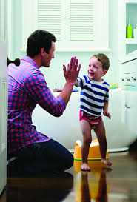



Reinforcement
Materials
Attention
You need to find a reward for having a void in the toilet
Examples:
Edible
Activities
Leaving the Bathroom

Slide 78
Treatment Components
Fluid Loading
Wearing Underwear
Reinforcement
Sit Schedule

Slide 79
Progressive Sit Schedule
Level | Duration of Sit | Inter-trip Interval
1. | 10 min | 5 min
2. | 10 min | 10 min
3. | 5 min | 15 min
4. | 5 min | 25 min
5. | 5 min | 35 min
6. | 5 min | 45 min
7. | 5 min | 60 min
8. | 5 min | 90 min
9. | 5 min | 2 hours
*Participants moved up or down levels based on time and accidents
      Leblanc,et. al., 2005

Slide 80
Increasing the Sit Schedule
3 continent voids in a row
Increase one level
3 accidents
in a row
Decrease one level

Slide 81
Treatment Components
Fluid Loading
Wearing Underwear
Communication Training
Reinforcement
Sit Schedule

Slide 82

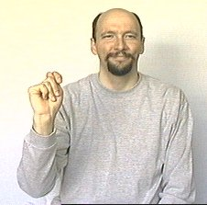

Communication Training
Before the child goes into the bathroom/sits on the toilet, prompt communication for the "bathroom.”
Potty Please
Picture Exchange
Sign Language
Vocal Communication

Slide 83
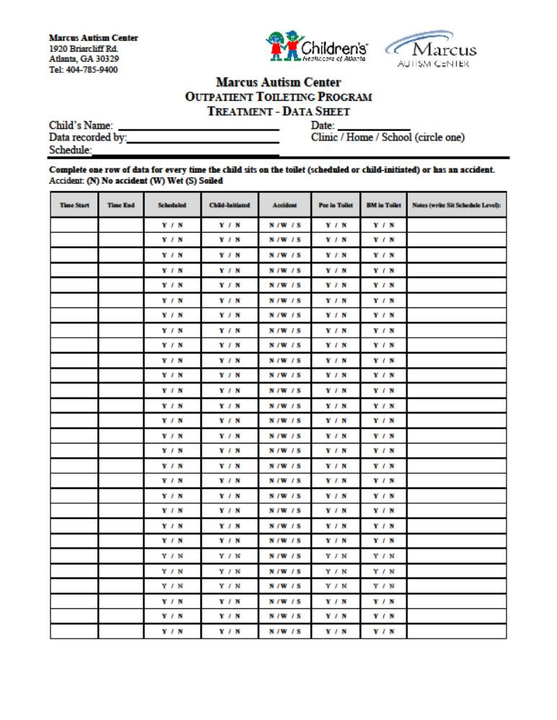

Slide 84


