Slide 1
TAND-Aggressive Behavior Management
2022 World TSC Conference
Moderator: Peter David
Speakers: Nathan Call, PhD, BCBA-D, David W. Dunn, MD, Tanjala T. Gipson, MD, Leslie Russell
July 29, 2022

Slide 2
Behavioral Treatments for Challenging Behavior
2022 World TSC Conference
Nathan Call, PhD, BCBA-D
Associate Professor – Emory University School of Medicine
Clinical Director – Marcus Autism Center
July 29, 2022

Slide 3
Behavioral Approaches to Challenging Behavior
There is a long history of behavioral interventions for problem behavior
Historically, these have shown the potential for success, but inconsistently

Slide 4
Vignette: Tim
Tim doesn’t have much functional communication
Tim hits his parents
Sometimes he hits them when they make him turn off the television
Sometimes he hits them when they tell him he has to brush his teeth

Slide 5
Topography
What the behavior looks like
  Examples of different topographies of aggression:
  Biting
  Kicking
  Hitting
  Scratching
  Head-butting
  Hair-pulling

Slide 6
Relationship between Topography and Treatment
Topography is less relevant than one might expect
Topographically prescribed treatments:
  Problem behavior “X” = Treatment “Y”
  Example: biting = time out
    Every time your child bites you should put him in time out

Slide 7
Relationship between Topography and Treatment
Topographically Prescribed Treatment:
  Hitting = time out
When Tim hits his parents after his parents turn off the television he goes to time out
When Tim hits his parents after being told to brush his teeth he goes to time out
  “When I hit, not only do I not get to watch television, I don’t get to do anything!”
  “When I hit I don’t have to brush my teeth!”

Slide 8
Relationship between Function and Treatment
Function: the consequences that maintain a response
  i.e., the purpose a behavior serves for the individual
Function-based treatment:
  Problem behavior maintained by consequence X = Treatment “Y”
  Example: biting maintained by attention = ignore
    Every time your child bites you should walk away from them

Slide 9
Vignette: Tim
Function-based Treatment:
  Hitting maintained by access to preferred activities = time out
  Hitting maintained by escape from demands = follow through with demand
When Tim hits his parents after his parents turn off the television and he goes to time out
When Tim hits his parents after being told to brush his teeth they follow through and make sure he brushes his teeth
  “When I hit, not only do I not get to watch television, I don’t get to do anything!”
  “When I hit, I still have to brush my teeth”

Slide 10
Two Categories of Functions
Social: the consequences is mediated by another person
Automatic: the behavior automatically produces the consequence

Slide 11
Automatic Functions
Often viewed as stimulatory
  Stereotypy (e.g., hand-flapping, body-rocking)
  Some forms of self-injury (e.g., head-banging)
Can result from underlying medical issues
  May increase general irritability

Slide 12
Identifying the Function of Problem Behavior
Gold standard is a Functional Analysis
  Direct manipulation of the environment in “analog” test and control conditions
  Sometimes compared to a “behavioral allergy test”

Slide 13
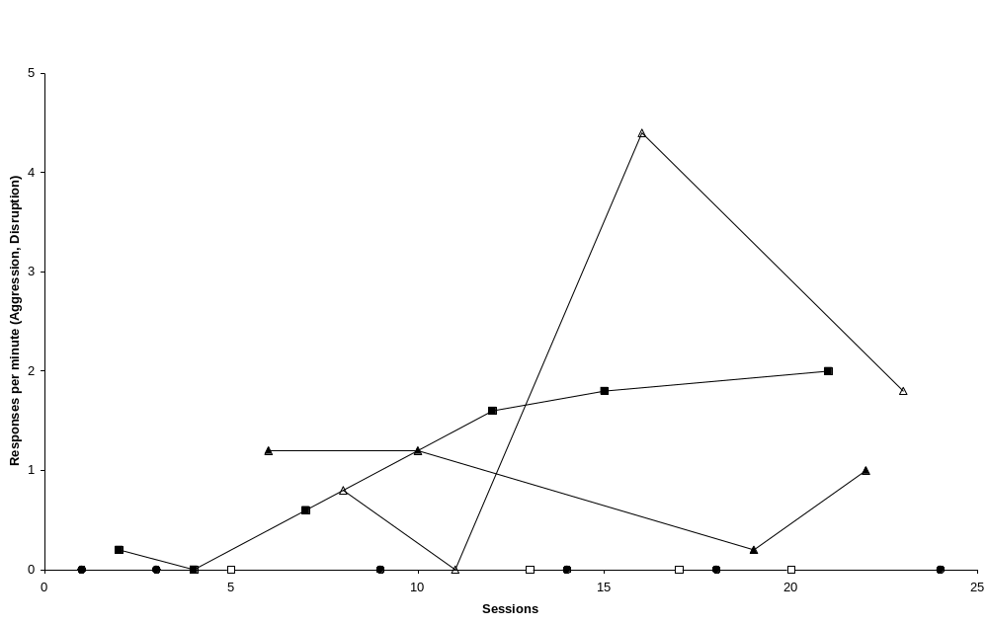
An Example of Functional Analysis

Slide 14
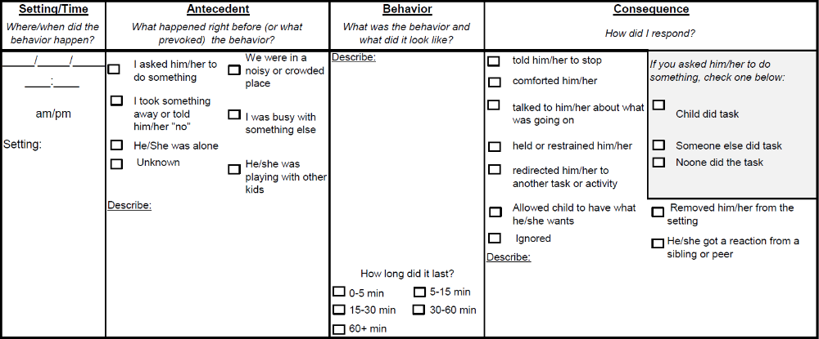
More Practical for Everyday Use

Slide 15
Four Approaches to Addressing Problem Behavior
1. Prevention: steps taken to avoid the occurrence of problem behavior
2. Behavioral Intervention: a set of procedures that will decrease (over time) the frequency of problem behavior
  Often designed/implemented by specialized personnel (e.g., BCBAs), sometimes in specialized settings
    A relatively new credential, so mileage may vary

Slide 16
Four Approaches to Addressing Problem Behavior
3. Behavior Management: a strategy that will decrease the impact/effects of problem behavior on the individual, caregivers, or the environment (but not the frequency/probability)
4. Crisis Management: doing whatever is necessary to minimize harm to individuals and/or the environment
  Problem behavior will not likely decrease and could even increase

Slide 17
Takeaway Messages
Understanding problem behavior from the individual’s perspective (i.e., its function) is the key to developing behavioral treatments
Good behavioral treatment plans address all phases of need: (prevention, management, intervention & crisis)
There are professionals with some training in implementing these (i.e., BCBAs)

Slide 18
Before Starting Medication
Why is the child aggressive? Pain, medical problems, medication, change in environment?
Are there other behavioral problems-autism, ADHD, anxiety, or depression
Is the behavioral treatment right for the child? Combined behavioral therapy and medication works much better than medication alone

Slide 19
Factors In Choosing a Medication
Psychiatric diagnosis
Age of the child
Evidence base for efficacy
Potential adverse effects
Comorbid conditions and potential drug interactions
Available forms and cost
Prior response of other family members and pharmacogenomics

Slide 20
Mild Aggression
Guanfacine and clonidine
Moderate efficacy for autism and ADHD
Adverse effects: sedation, decreased blood pressure and pulse
No effect on seizure threshold

Slide 21
Moderate to Severe Aggression
Antipsychotics
Autism-good evidence for risperidone, aripiprazole, and haloperidol
ADHD-moderate improvement with stimulant and antipsychotic
No effect on seizure threshold

Slide 22
Side Effects of Atypical Antipsychotics
Weight gain
Metabolic syndrome
Elevated prolactin
Prolongation of QTc interval
EPS
others

Slide 23
Moderate to Severe Aggression
Stimulants: methylphenidate and amphetamine
ADHD-good evidence of efficacy
Autism-moderate evidence
No effect on seizure threshold

Slide 24
Stimulants: Adverse effects
Most common: headache, stomachache, decreased appetite, insomnia
Preschool age children: irritable dysphoria
Less common: increased heart rate, increased blood pressure, tics, skin picking and nail biting, reduced growth rate
Rare: hallucinations, mania
Adverse effects more likely in children with autism

Slide 25
Other options-limited evidence
Other antipsychotics: olanzapine (weight gain), quetiapine (sedation, increased weight), clozapine (drop in white blood cells, seizures, weight gain)
Mood stabilizers: valproic acid, carbamazepine, lamotrigine, lithium
Buspirone, propranolol, antidepressants

Slide 26
Seizure Risk for Psychotropic Drugs (Alper et al. Biol Psychiatry 2007)
Drug | Standardized Incidence ratio
Clozapine | 9.50
Olanzapine | 2.50
Quetiapine | 2.05
Other antipsychotics | 1.03
Bupropion IR | 1.58
All other antidepressants | 0.31
clomipramine | 4.08

Slide 27
CBD: new miracle drug?
Used for seizures, spasticity, pain, sleep, anxiety, and aggression
Problems: inadequate data and unknown dosing of over the counter preparations
Autism:
Barchel et al. decreased rage, SIB, and hyperactivity and improved sleep in 68%, worse 5-9% Front Pharm 2019
Schleider et al. Less rage, restlessness, and agitation in 80-90%, worse 10% Nature 2019

Slide 28
Aggression and Medication Summary
Assess for medical and environmental triggers
Assess for associated psychiatric conditions: ADHD and disruptive behavior disorders, autism spectrum disorders, mood disorders, anxiety, psychosis
Start with behavioral therapy
Use psychopharmacology based on associated condition

Slide 29
TAND: Aggressive Behavior Management
2022 World TSC Conference
Tanjala T. Gipsn, M.D.
July 29, 2022

Slide 30
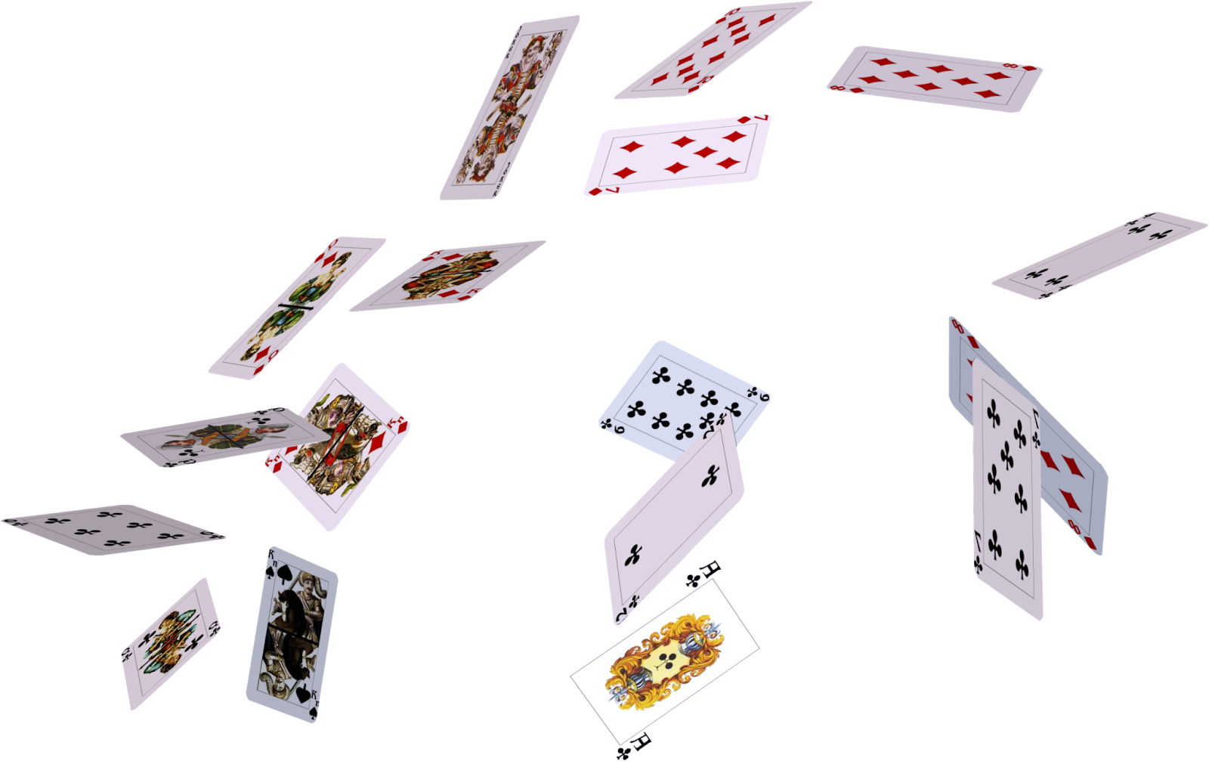
This Photo by Unknown Author is licensed under CC BY-NC

Slide 31
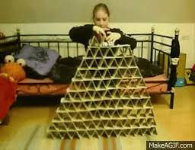

Slide 32
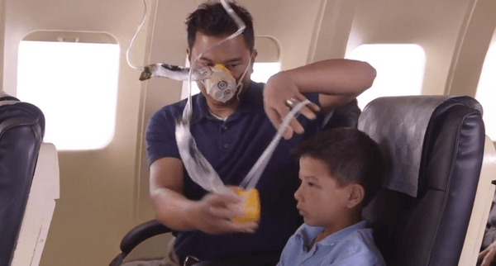
Nap
Hand
Time
Walk
Drink
This Photo by Unknown Author is licensed under CC BY

Slide 33
Medical
Dental
GI

Slide 34
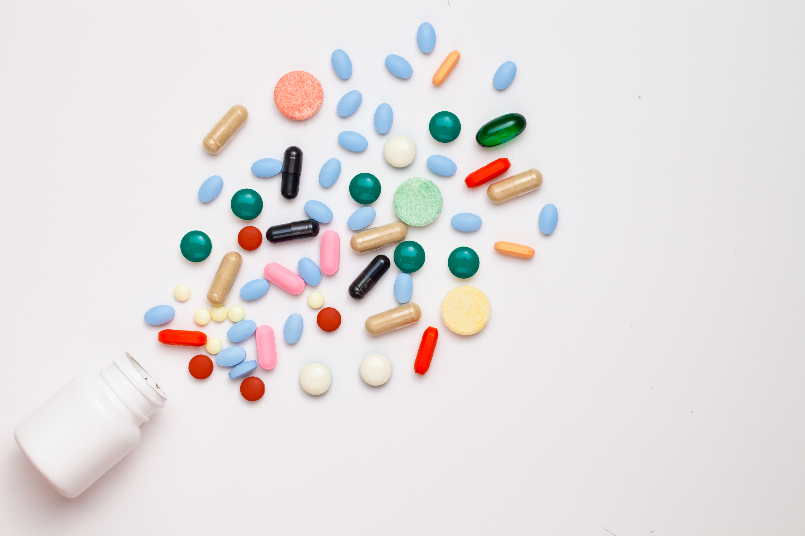
Medications
Generic change
Side effects

Slide 35
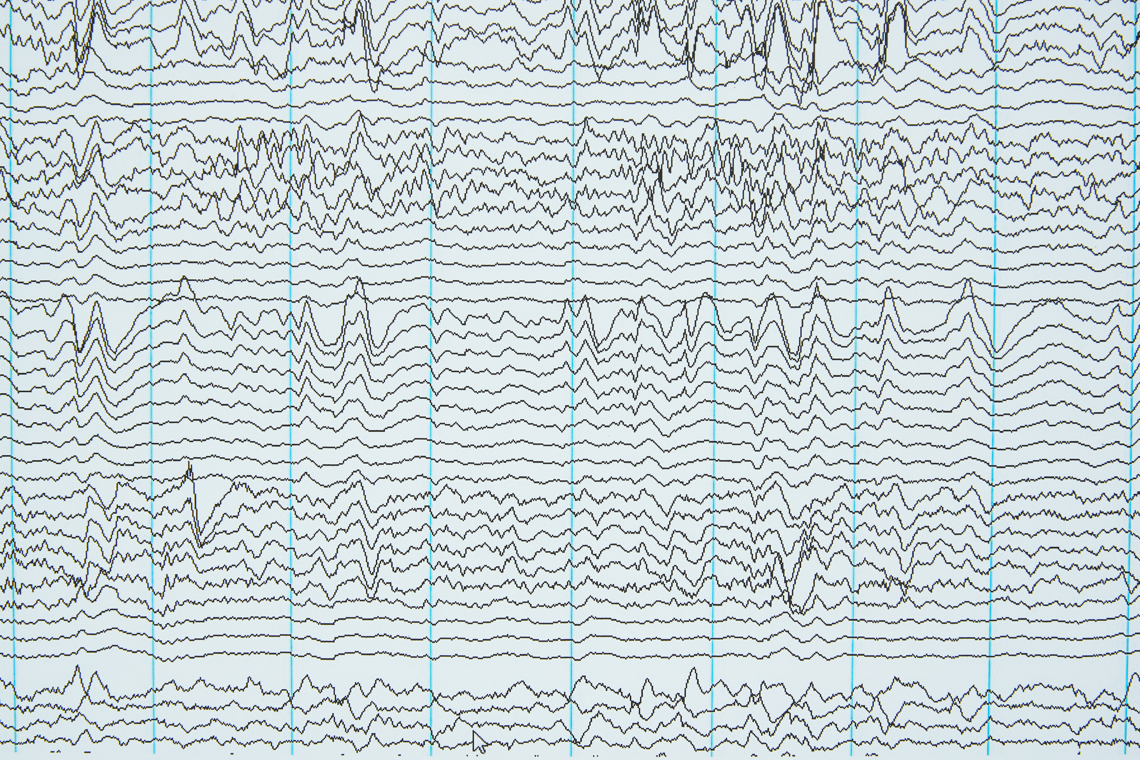


Slide 36
Other changes?
Hormonal
Environmental
Sleep
Expectations

Slide 37
Re-evaluate the plan
Behavior plan check up
Medication targets appropriate?

Slide 38
Derrick

Slide 39
Derrick
Derrick is a 19 y/o young man with clinically definite TSC living in a group home after his father passed away. He has also been diagnosed with autism, anxiety and ADHD. He has a remote history of aggression and self-injury which has resolved with behavior therapy and medication management.

Slide 40
Derrick
During a scheduled TAND clinic follow up visit, his team reports new complaints of spitting and hitting other residents.
The team responds by telling him, ‘Don’t do that!’, ‘That’s nasty!’ and then they remove him from the common area.
Medical review was negative.
Behavior plan check up:
  Function – Access to attention
Change: Mom’s new boyfriend; visit schedule

Slide 41
Derrick
Strategy
  Reassurance
  Wall calendar with Mom’s visit schedule
  Behavior intervention plan adjustment
    Removal of verbal feedback
    Silent relocation to a private area

Slide 42



Slide 43
Don’t Go It Alone

Slide 44
You’re Not a Failure

