Slide 1

Therapeutic Strategies for Drug-Resistant Epilepsy in TSC
2022 World TSC Conference
Breakout Session: Refractory Epilepsy – Now What?
July 30, 2022
Michael Wong, MD, PhD
Allen P and Josephine B Green Professor of Pediatric Neurology
Director, Washington University Tuberous Sclerosis Center
Department of Neurology, Pediatrics, and Neuroscience
Washington University School of Medicine
St. Louis, MO USA

Slide 2
Outline
Goals of Treating Drug-Resistant Epilepsy
Overview of Treatment Options for Drug-Resistant Epilepsy
Medication Strategies for Drug-Resistant Epilepsy
Neurostimulation Strategies for Drug-Resistant Epilepsy

Slide 3
Outline
Goals of Treating Drug-Resistant Epilepsy
Overview of Treatment Options for Drug-Resistant Epilepsy
Medication Strategies for Drug-Resistant Epilepsy
Neurostimulation Strategies for Drug-Resistant Epilepsy
Notes:
First, definition of DRE

Slide 4
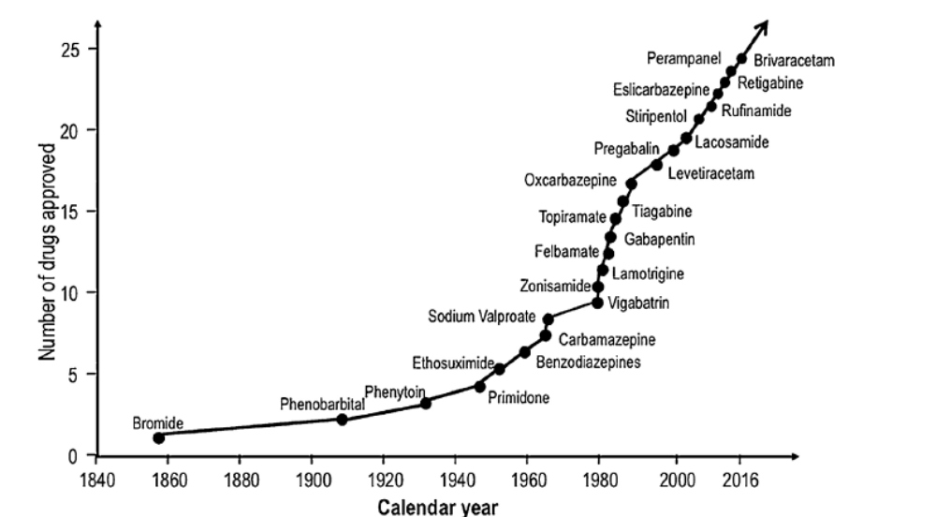
Antiseizure Medication (ASM) Development
Fenfluramine (2020)
Cenobamate (2019)
Everolimus (2018)
Cannabidiol (2018)
Modified from Golyala and Kwan Seizure 2017
Notes:
DRE defined by responsiveness to ASM

Slide 5
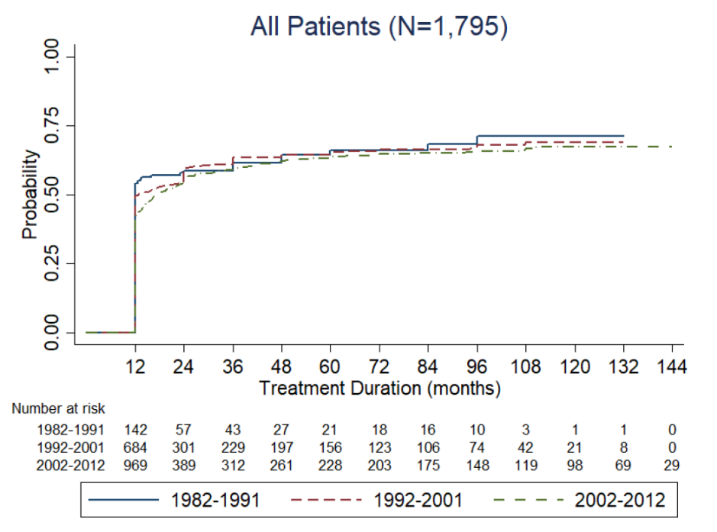
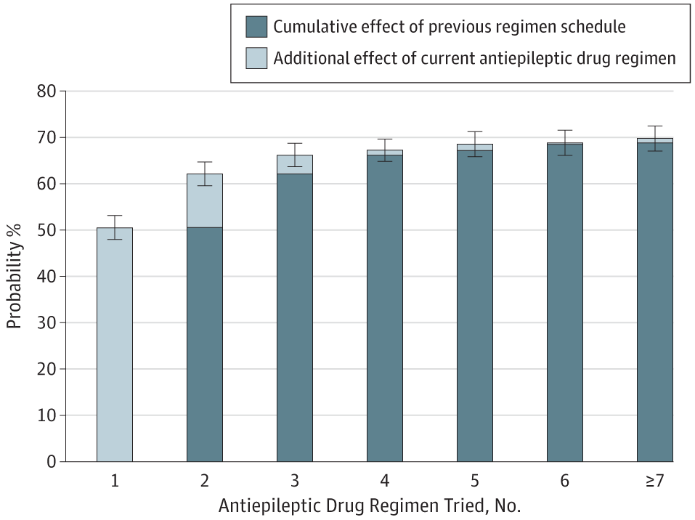
Drug-Resistant Epilepsy
- Approximately one-third of patients with epilepsy are intractable to all antiseizure medications (i.e.. failure to become seizure-free).
- Despite over >20 new drugs in 30 years, % of drug-resistant epilepsy remains the same.
- In newly diagnosed epilepsy patients, law of diminishing returns with each drug tried. Drug- resistance can be predicted after failure of two drugs.
Seizure-free Probability
Seizure-free Probability, %
Chen et al. 2018 JAMA Neurology
Notes:
If seizure-freedom is used as most relevant outcome measure

Slide 6
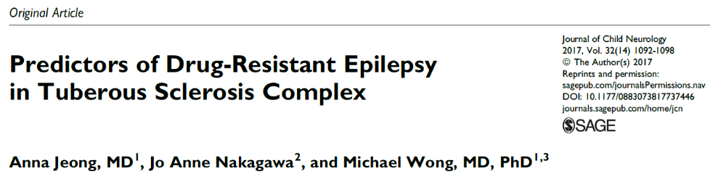
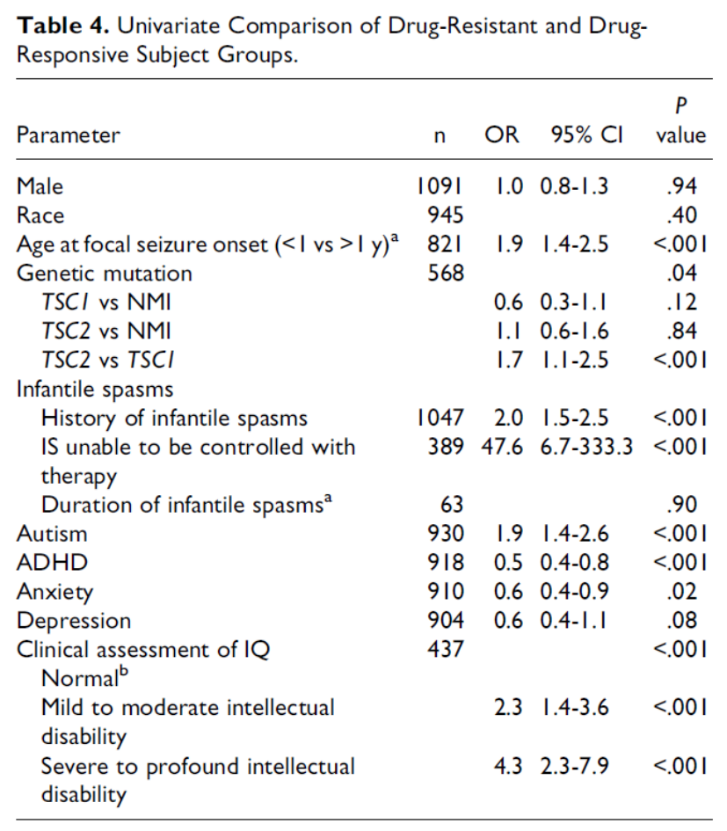
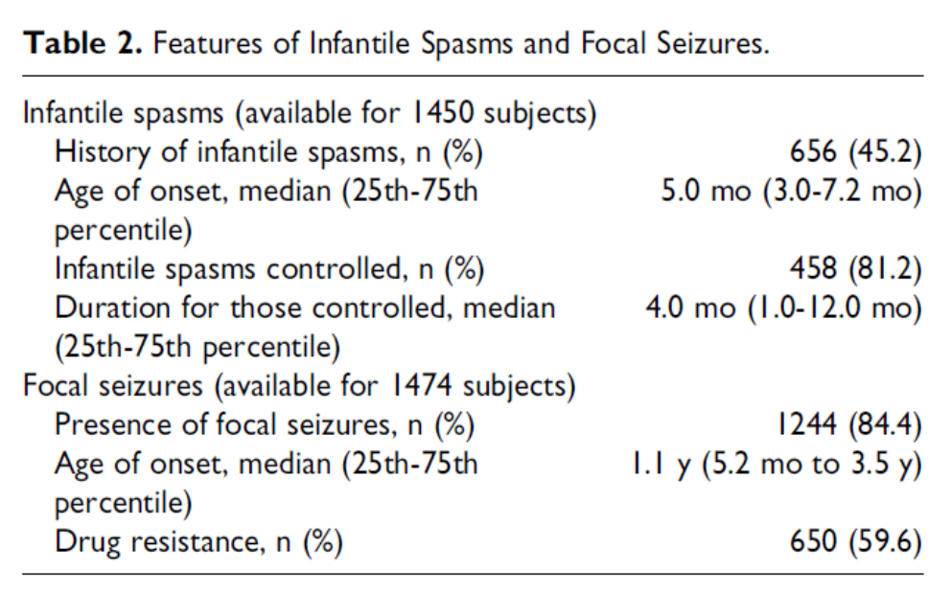
Epilepsy in TSC: Predictors of Drug-Resistant Epilepsy
Jeong et al. J Child Neurol 2017

Slide 7
Realistic Goals of Treating Drug-Resistant Epilepsy
Seizure Freedom (ideal) – i.e. eliminate seizures
2) Minimize seizure frequency and severity
3) Minimize medication side effects (trade-off with seizure control)
4) Reduce risk of status epilepticus and SUDEP
5) Optimize quality of life

Slide 8
Outline
Goals of Treating Drug-Resistant Epilepsy
Overview of Treatment Options for Drug-Resistant Epilepsy
Medication Strategies for Drug-Resistant Epilepsy
Neurostimulation Strategies for Drug-Resistant Epilepsy

Slide 9
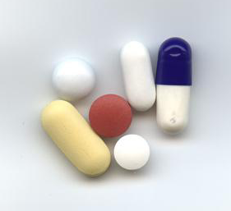
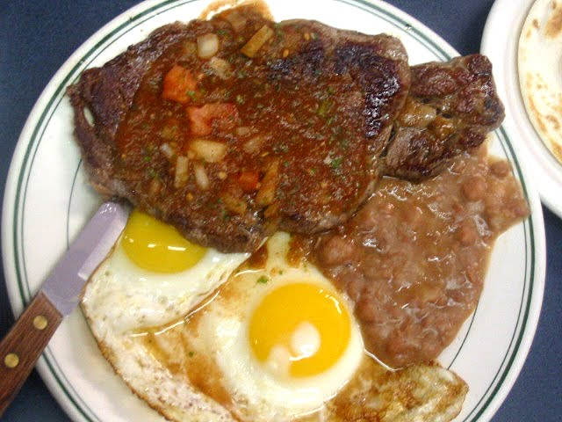
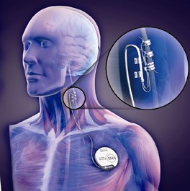

Current Treatments for Drug-Resistant Epilepsy
Seizure Medication
Epilepsy Surgery
Ketogenic Diet
Neurostimulation

Slide 10
Outline
Goals of Treating Drug-Resistant Epilepsy
Overview of Treatment Options for Drug-Resistant Epilepsy
Medication Strategies for Drug-Resistant Epilepsy
Neurostimulation Strategies for Drug-Resistant Epilepsy

Slide 11
Treatments for Epilepsy: Medication
1857 Bromide
1912 Phenobarbital
1938 Phenytoin
1952 Primidone
1957 Methsuximide
1960 Ethosuximide
1968 Diazepam
1974 Carbamazepine
1975 Clonazepam
1978 Valproate
1993 Felbamate
1993 Gabapentin
1994 Lamotrigine
1996 Topiramate
1997 Tiagabine
1999 Levetiracetam
2000 Oxcarbazepine
2000 Zonisamide
2004 Pregabalin
2008 Rufinamide
2009 Lacosamide
2009 Vigabatrin
2011 Ezogabine
2011 Clobazam
2012 Perampanel
2013 Eslicarbazepine
2016 Brivaracetam
2018 Everolimus
2018 Cannabidiol
2019 Cenobamate
2020 Fenfluramine
2021 Ganaxolone
1st generation
2nd generation
3rd generation
Notes:
30 ASMs available. Pts with DRE already tried on multiple meds and unlikely to become seizure-free, so non-medical options should be tried, but still potential benefits..

Slide 12
Medication Strategies for Drug-Resistant Epilepsy: Targeting specific seizure types
“Broad-spectrum” anti-seizure medications are effective against multiple seizure types, both generalized and focal, and are often preferred, due to the bilateral/multifocal nature of epilepsy and multiple seizure types in many TSC patients.
  Levetiracetam (Keppra)
  Topiramate (Topamax)
  Valproic acid (Depakote)
  Lamotrigine (Lamictal)
“Focal” anti-seizure medications can also be used in TSC patients, especially those with focal seizures, but should be used more cautiously if they have multiple seizure types, multifocal/generalized seizures, or infantile spasms.
  Carbamazepine (Tegretol)
  Oxcarbazepine (Trileptal)
  Gabapentin (Neurontin)
  Lacosamide (Vimpat)
Medications for infantile spasms.
  Vigabatrin (Sabril)
  ACTH
  Oral steroids
  Clobazam (Onfi)
  Zonisamide (Zonegran)
  Rufinamide (Banzel)
  Felbamate (Felbatol)
Notes:
With 30 meds to choose from, first consideration in selecting medication

Slide 13
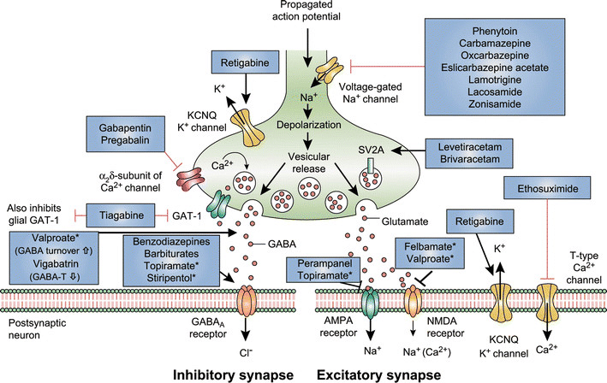
Medication Strategies for Drug-Resistant Epilepsy: Diversifying/Complementing Mechanisms of Action
Loscher et al. 2016 CNS Drugs
Notes:
Secondly, as patients with DRE on multiple meds, often two or more at a time

Slide 14
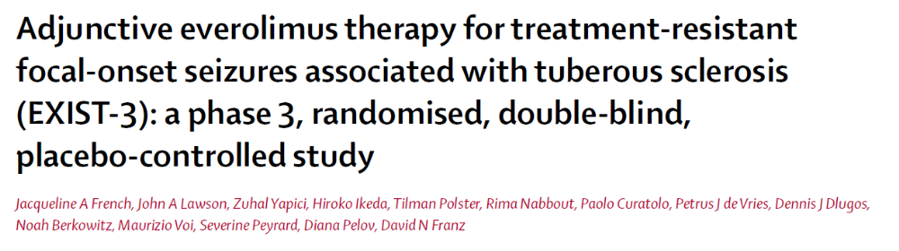

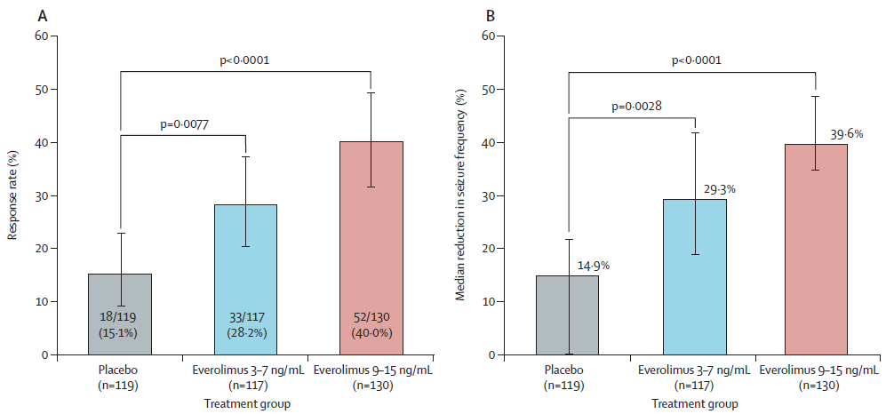
Medication Strategies for Drug-Resistant Epilepsy: The role of mTOR inhibitors in TSC-related epilepsy

Slide 15

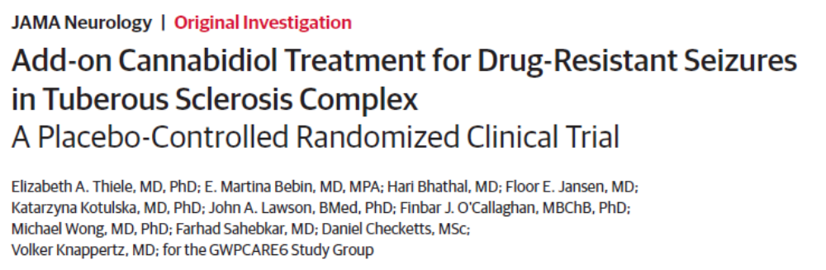
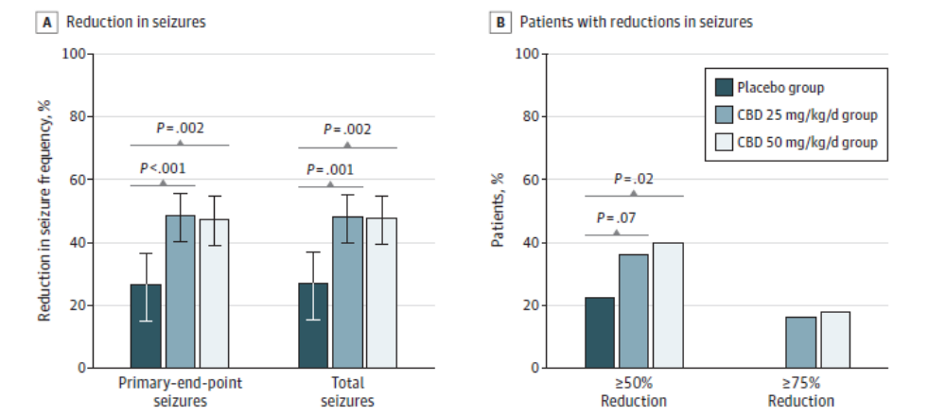
Medication Strategies for Drug-Resistant Epilepsy: The role of cannabidiol in TSC-related epilepsy

Slide 16
Medication Strategies for Drug-Resistant Epilepsy: Avoiding/selecting specific medication side effects
All anti-seizure medications can have the common dose-related side effects of sleepiness, dizziness, and unsteadiness, especially at high doses.
Partial list of more specific or serious side effects of individual medications:
  Carbamazepine (Tegretol): rash, bone marrow toxicity, liver toxicity
  Everolimus (Afinitor): oral ulcers, hyperlipidemia, immunosuppression
  Felbamate (Felbatol): appetite suppression, insomnia, liver toxicity, bone marrow toxicity
  Lamotrigine (Lamictal): rash, other severe allergic reaction (Steven-Johnson’s syndrome)
  Levetiracetam (Keppra): behavioral problems, psychosis.
  Oxcarbazepine (Trileptal): rash, low sodium
  Topiramate (Topamax): appetite suppression, weight loss, kidney stones, decreased sweating, word-finding difficulties.
  Valproic acid (Depakote): weight gain, tremor, hair loss, liver toxicity, bone marrow toxicity
  Vigabatrin (Sabril): visual field constriction
  Zonisamide (Zonegran): similar to topiramate
Notes:
Efficacy, ideally seizure freedom is main goal of treatment. The flip side

Slide 17
Outline
Goals of Treating Drug-Resistant Epilepsy
Overview of Treatment Options for Drug-Resistant Epilepsy
Medication Strategies for Drug-Resistant Epilepsy
Neurostimulation Strategies for Drug-Resistant Epilepsy

Slide 18
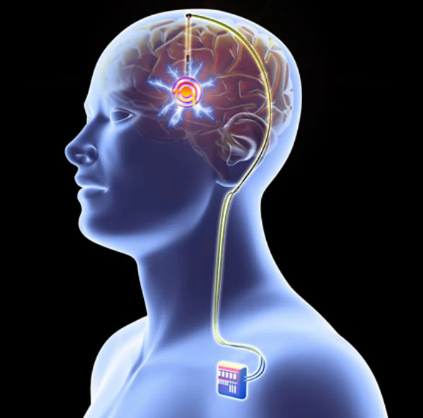
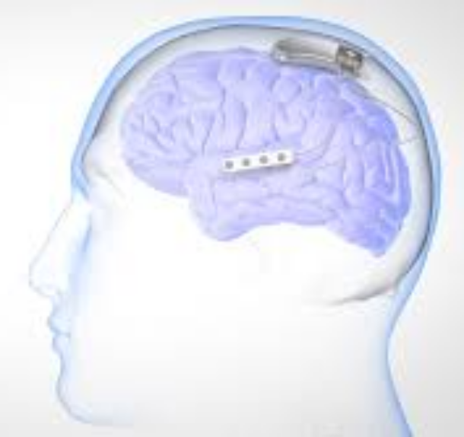
Neurostimulation Strategies for Drug-Resistant Epilepsy
Vagal nerve stimulation (VNS) stimulates the vagus nerve in the neck leading to the brain. Surgery to implant into chest wall, but relatively few side effects.
Deep brain stimulation (DBS) stimulates regions deep within the brain (thalamus), which indirectly may affect the seizure focus.
Responsive neurostimulation (RNS) stimulates the seizure focus in the brain itself. Primarily used for when it is risky to remove the seizure focus (e.g., seizure focus is in “eloquent cortex” ).
VNS
DBS
RNS

Slide 19
Neurostimulation Strategies for Drug-Resistant Epilepsy
Efficacy: reduction in seizures, rare seizure freedom. Efficacy may increase over time (months to years).
Minimal side effects, besides risks/side effects of surgical implantation. Secondary goal to reduce medications and medication side effects.
VNS
DBS
RNS

Slide 20
Summary
Drug-resistant epilepsy, defined as failure of at least two antiseizure medications to make a patient seizure-free, is very common in TSC.
Ideally the goal of treatment is seizure freedom, but this may be difficult to achieve in drug-resistant epilepsy. Minimizing seizure frequency and severity and reducing side effects are intermediary goals.
Medication strategies for drug-resistant epilepsy include targeting specific seizure types, diversifying mechanisms of action, and avoiding specific side effects.
Non-medical options for drug-resistant epilepsy should be considered, including evaluation for epilepsy surgery, dietary therapy, and neurostimulation. Neurostimulation has moderate efficacy, but minimal side effects.

Slide 21

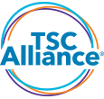




Acknowledgements
TSC Basic Research
TSC Clinical Research
Grant Support
Wong Laboratory
Nicholas Rensing
Tom Foutz
Dongjun Guo
Lirong Han
Jack Friedman
Kevin Johnson
Bo Zhang
Washington University
Ashley Fasciola
Laura Jansen
Olga Novak
Robin Ryther
Anna Jeong
National Institutes of Health
Department of Defense TSCRP
TSC Alliance
McDonnell Center
Missouri Department of Mental Health
TSC Clinical Research Consortium
Martina Bebin – Univ Alabama (PREVeNT PI)
Darcy Krueger – Cincinnati (STOP2 PI)
Michael Frost – Minnesota
Shefali Jeste – UCLA
Hope Northrup – Houston
Brenda Porter – Stanford
Mustafa Sahin – Boston Children’s
Collaborators
David Brody
Rafael Galindo
David Gutmann
David Holtzman
Laura Jansen
Eleanor Aronica - University of Amsterdam
Peter Crino – University of Maryland
Steve Danzer - Cincinnati
Kevin Ess – Vanderbilt
David Kwiatkowski – Harvard
Lingui Zeng - Zhejiang University

Slide 22
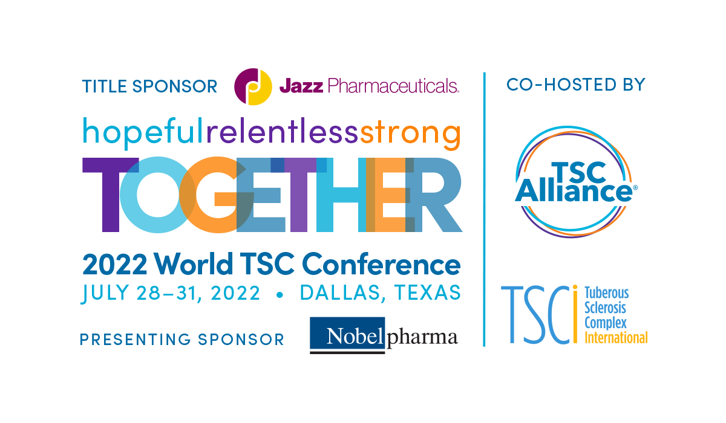
Use as final slide

