Slide 1


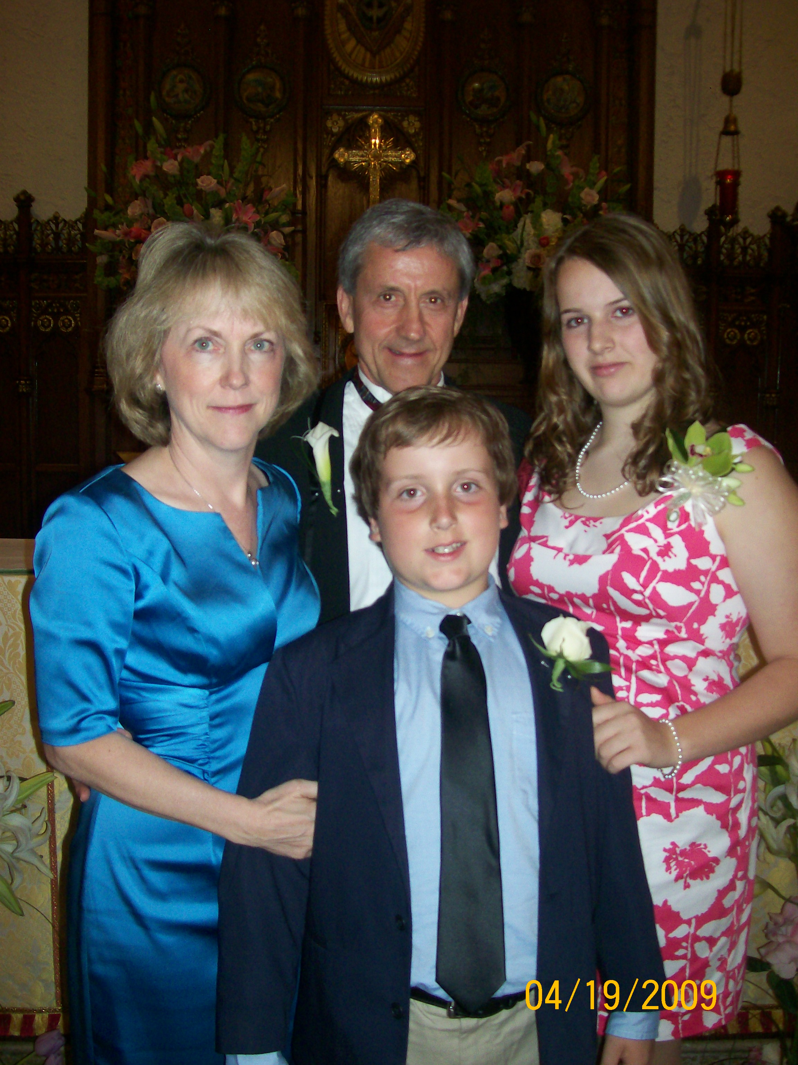
Hope Northrup-Passions
  Family-Husband Ed, daughter Martha (she is going to be a Child Neurologist-I wonder why?), son Daniel and son-in-law, Travis
  Tuberous sclerosis complex (TSC)-since 1987!-first hunting for the causative genes followed by trying to contribute to figuring out how the genes work and finally being able to use all of the information to treat patients
  Favorite thing about TSC-YOU! Patients with TSC and their families

Slide 2
Use as final slide

Slide 3
Roadmap to Updated TSC Consensus Guidelines
2022 World TSC Conference
Hope Northrup, MD
McGovern Medical School, University of Texas Health Science Center at Houston (UTHealth)
July 29, 2022

Slide 4
Background
Original TSC Consensus Conference 1998 with 2nd TSC Consensus Conference 2012 (80 experts from 14 countries)
All Chairs and Working Group Co-Chairs from 2012 Conference areas were invited to meet face-to-face at 2018 TSC World on Dallas, TX, July 25-26
Pre-work included reviewing all new literature published since 2013 which was then discussed in working group meetings (telephone, email) prior to face-to-face meeting at TSC World 2018
At face-to-face meeting, changes/updates/additions to Diagnostic Criteria and Surveillance and Management Guidelines determined
Output published in Pediatric Neurology 123 (2021) pp 50-66 AVAILABLE for those who want ALL details

Slide 5
Diagnostic Criteria –Why Do We Need/Want?
Rapid diagnosis and consistent characterization of disease
Determine extent of phenotype
Must be updated as new information is discovered

Slide 6
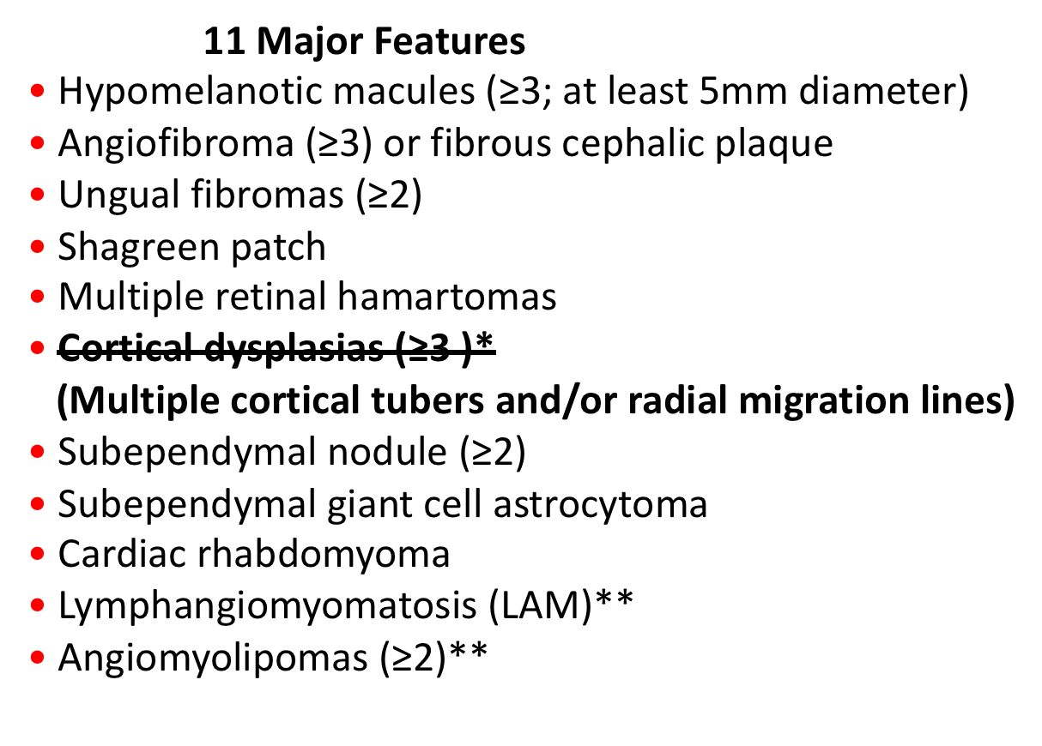
Diagnostic Criteria Updates
7 Minor Features
“Confetti” skin lesions
Dental enamel pits (≥3)
Intraoral fibromas (≥2)
Retinal achromic patch
Multiple renal cysts
Nonrenal hamartomas
Sclerotic bone lesions

Slide 7
Diagnostic Criteria: Genetic Testing
Recommendation: A pathogenic mutation* in TSC1 or TSC2 is diagnostic for TSC
*Most TSC-causing mutations are sequence variants that clearly prevent TSC1 or TSC2 protein production. Some mutations compatible with protein production (e.g. some missense changes) are well established as disease causing . Other variants should be considered with caution.
No changes to the recommendations from 2012
HOWEVER
Greater recognition of variability in TSC and more powerful testing options

Slide 8
Updated Surveillance and Management Recommendations
Provided for: newly diagnosed AND already diagnosed (following)
One to two highlights per organ system
Full article available on line free thanks to Pediatric Neurology (Dr. Steve Roach Editor)
Map to other sessions on the organ system
DISCLAIMER: no information about TAND will be presented as Dr. Petrus de Vries will speak next

Slide 9
Updated Surveillance and Management Recommendations-Overall
Increased emphasis on early screening for EEG abnormalities
Enhanced surveillance and management of TSC-associated neuropsychiatric disorders
New medication approvals

Slide 10
Genetics
DISCUSSION: Women's Health Issues for TSC Adults, Edelweiss, July 29th (Friday) 1-2:30
Moderator: Brenda Porter, MD, PhD
Speakers: Danielle Clark; Lara Friel, MD, PhD; Lisa Henske, MD;
Hope Northrup, MD; Emily Phan
LECTURE: Genetics Made Simple, Grand Ballroom D & E, July 29th (Friday) 3-4:30
Moderator: Steven Sparagana, MD
Speakers: Jennifer Glass, MS, CGC, LGC; Hope Northrup, MD; Zacil-Ha Vilchis Zapata, MD
PANEL: Genetics, Reproductive Issues and Impact on Relationships, Grand Ballroom A, July 30th (Saturday) 1-2:30
Moderator: Joshua Samuels, MD, MPH
Panelists: Lara Friel, MD, PhD; Jennifer Glass, MS, CGC, LGC; Angela Peron, MD

Slide 11
Brain and Tumors
Brain MRI (CT if not available) with and without contrast
Imaging 1-3 years depending on brain findings until 25 years old; imaging thereafter if known SEGA or neuro sxs
Surgery for SEGA if acute deterioration
Medical therapy (mTORis) or surgery (decision to make between patient and care providers) if asymptomatic growing or large SEGAs; secondary benefit is tx of other TSC-associated medical issues

Slide 12
Brain and Tumors
PANEL: Surgical Approaches and Assessments for Epilepsy and SEGA, Grand Ballroom A; July 29th (Friday) 1:00 p.m. – 2:30
Moderator: Dan Curry, MD
Panelists: Jeffrey Blount, MD; Asim Choudhri, MD; Gerald Grant, MD; Howard Weiner, MD

Slide 13
Brain and Seizures
Routine EEG every 6 weeks until 12 months; then every 3 months until 24 months
Abnormal EEG often precedes clinical seizures
Vigabatrin first-line for infantile spasms; ACTH or prednisolone if no improvement with Vigabatrin after 2 weeks
For other seizures, usual AEDs
Everolimus and a specific cannabidiol formulation approved for use in TSC-associated epilepsy
Epilepsy surgery should be considered with refractory epilepsy early on (especially if regression is occurring); particularly after failing 3 AEDs

Slide 14
Brain and Seizures
SPECIALTY: Using Technology to Your Advantage: Seizure Monitoring, Empowering Communication for the Nonverbal, and Futuristic Medical Care, Grand Ballroom B, July 29th (Friday) 10:30-12:00
Moderator: M. Scott Perry, MD
Speakers: Debora Moritz, Rob Moss, Rahul Vipparthi
LECTURE: Seizure Types and Treatments, Grand Ballroom D & E, July 29th (Friday) 10:30-12
Moderator: Rohini Coorg, MD
Speakers: Mark Keezer, MDCM, PhD; Elizabeth Thiele, MD, PhD; Jim Wheless, MD
DISCUSSION: Preparing Your Family for Epilepsy Surgical Evaluation and Surgery, Edelweiss, July 29th (Friday) 10:30-12
Moderator: Brenda Porter, MD, PhD
Speakers: Bridget Britt; Gerald Grant, MD; Dave and Rachel Johnson

Slide 15
Brain and Seizures
WORKSHOP: Seizure Action Plans and Rescue Meds, Plum Blossom, July 30th (Saturday) 10:30-12
Moderator: Michael Frost, MD
Speakers: Peter Davis, MD; Pradnya Gadgil, MBBS, MRCPCH; Rob Moss; Rebecca Schultz, PhD, APRN, CPNP
SPECIALTY: Refractory Epilepsy – Now What?, Grand Ballroom B, July 30th (Saturday) 1-2:30
Moderator: Jim Wheless, MD
Speakers: Peter Crino, MD, PhD; Sergiusz Jóźwiak, MD, PhD; Elizabeth Thiele, MD, PhD; Michael Wong, MD, PhD
DISCUSSION: What’s Next? Tools to Empower You on Your Medical Journey to an Adult Neurologist, Edelweiss, July 30th (Saturday) 3-4:30
Moderator: Klaus Werner, MD, PhD
Speakers: Derek Bauer, MD; Elizabeth Thiele, MD, PhD

Slide 16
Kidneys
Abdominal MRI 1-3 every years
Annual assessment with U/A, BP, GFR
Acute hemorrhage tx with embolization followed by corticosteroids
Asymptomatic, growing AMLs >3 cm, first-line tx is mTORi (superior to surgical or ablative tx)

Slide 17
Kidney
LECTURE: Kidney Tumors, Cysts and Treatment Options, Grand Ballroom D & E, July 30th (Saturday)10:30-12
Moderator: Chris Kingswood, MD
Speakers: John Bissler, MD; Oded Volovelsky, MD, PhD
SPECIALTY: Managing Progressive Kidney Disease, Grand Ballroom B, July 30th (Saturday) 3-4:30
Moderator: John Bissler, MD
Speakers: Chris Kingswood, MD; Joshua Samuels, MD, MPH

Slide 18
Lungs
Perform baseline chest CT in all females and symptomatic males at 18 years of age
If positive, pulmonary referral and follow up scans tailored to circumstances
Use mTORi tx for LAM in patients with abnl lung function (FEV1 <70% predicted), physiological evidence of substantial disease burden, air trapping, resting or exercise-induced O2 desat, rapid decline of function or problematic chylous effusions
Repeat screen in negative females every 5-7 years through menopause
Counsel patients about multiple issues surrounding exposures (smoking, etc), other med use (estrogens, etc) and pregnancy

Slide 19
Lungs
SPECIALTY: LAM, Treatment Options and Clinical Trials, Grand Ballroom B, July 29th (Friday) 3-4:30
Moderator: Susan Sherman, MHA
Speakers: Nishant Gupta, MD; Lisa Henske, MD; Joel Moss, MD, PhD

Slide 20
Skin and Teeth
Skin-annual skin exam for children with adults as indicated by findings; education about sun exposure
Skin-treat flat or minimally elevated lesions with topical mTORis; if no improvement, consider laser or surgical interventions
Teeth-examine every 6 months including annual panoramic x-rays
Teeth-symptomatic or deforming oral fibromas or jaw cysts may be treated with surgical excision or curettage

Slide 21
Skin and Teeth
LECTURE: Skin and Dental Manifestations and Treatment
Options, Grand Ballroom D & E, July 29th (Friday) 1-2:30
Moderator: Klaus Werner, MD, PhD
Speakers: Elizabeth Gosnell, DMD, MS; Joyce Teng, MD, PhD

Slide 22
Other –Heart, Eyes, Liver, Pancreas
Heart-obtain echocardiogram every 1-3 years in pediatric patients with identified cardiac rhabdomyomas; more frequently if issues
Heart-ECG every 3-5 years to monitor for conduction defects
Eyes-initial then annual; mTORis have been used in aggressive retinal astrocytic hamartomas; monitoring for changes in children on Viagabatrin
Refer patients with pancreatic endocrine tumors (PNETs) to endocrinology for evaluation and monitoring

Slide 23
Other –Liver, Pancreas, Heart and Eyes
PANEL: Other Organ Manifestations - Liver, Pancreas, Heart
and Eyes, Grand Ballroom A, July 31st (Sunday) 8:30-10
Moderator: Rajsekar Rajaraman, MD
Panelists: Mary Aronow, MD; Darcy Krueger, MD, PhD; David
Rodriguez-Buritica, MD

Slide 24
Thank You!

